Slide 1
Clinical Trial Design Committee: Designing More Efficient Trials
BMT CTN State of the Science Meeting
March 10, 2021

Slide 2
Conflict of Interest Disclosure
No conflicts to report.

Slide 3
Committee Members
Amer Beitinjaneh
Peter Dawson
Nancy Geller
Haesook Kim
Eric Leifer
Brent Logan
Brian Shaffer
Jesse Troy
Maggie Wu
Vicky Wu
Dan Weisdorf

Slide 4
Strategy
Creating disease-specific efficient trial designs

Slide 5
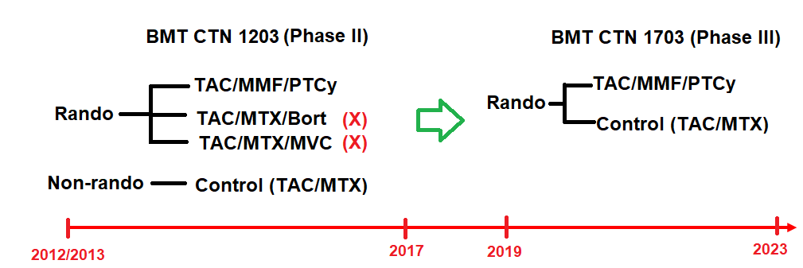
Opportunity to Accelerate Research
Example. PROGRESS 1 (BMT CTN 1203) &PROGRESS III (BMT CTN 1703)

Slide 6
Adaptive Platform Trial
Studies multiple treatments for a single disease continually
Treatment arms can be dropped and added
Arm A
Arm B
Arm B
Arm C
1/1/2022
1/1/2023
Notes:
Treatment A ready to go, but treatment B not initially available or identified.

Slide 7
Operational Aspects of a Platform Trial Adaptive Platform Trials Coalition Nat Rev Drug Discov (2019)
Master protocol
Modular format
Generic elements included in master protocol
Trial adaptations, e.g., adding new intervention, included in separate appendices
Use a centralized institutional review board
Data safety monitoring plan
Requires an experienced DSMB to oversee trial adaptations
Ensure adequate firewalls between the steering committee and the biostatistical team responsible for trial adaptations
Periodically report the platform trial results, e.g., with each new adaptation

Slide 8
Proposed SOSS Phase II Platform Trials
Steroids plus novel agents for high-risk GI GVHD
Post-HCT maintenance therapies for:
High-risk AML
Myeloid malignancies harboring p53 mutations
Advantageous for finding targeted therapies in subpopulations
Discourage evaluating experimental treatments against historical rate
Unknown biases can exist, e.g., temporal changes in patient selection
Notes:
Coordination of INDs particularly with industry partners
Trial financing doesn’t meet typical NIH paradigm
BEAT AML: Uses prospective genomic profiling. non-profit organization?

Slide 9
Challenges for Phase II Trials
Need to have a reliable shorter-term endpoint, e.g., PFS
Evolving biomarker panels
How to decide which treatments advance to phase III?
Successful phase II platform needs:
Ability to advance arm to phase III and start new arm in phase II
Flexibility to go beyond standard funding cycle
Industry fee per participant or treatment arm
Non-profit organizations
Beat AML Master Clinical Trial, Leukemia and Lymphoma Society
Notes:
Need to have a reliable shorter-term endpoint, e.g., PFS. True for any phase 2 trial.

Slide 10
Phase II/III Platform Trials
More difficult to conduct than phase II platform trial
Industry partner would typically want compare to single control arm
What to do if an experimental arm is better than control arm?
May not be able to pre-specify proper action
Worth considering pros/cons of various phase II/III designs
“Design issues in randomized phase II/III trials” (Korn, Freidlin, et al. 2012)
Notes:
When biomarker panels are evolving, they may not be suitable for launching a phase II APT followed by a phase III trial.

Slide 11
Stand-Alone Randomized Phase II and III Trials
Phase II
Phase III
A (control)
A (control)
Rando
B
Rando
C
C (or something newer)
Pros
10% chance of continuing to phase III if ineffective experimental arms
Complete phase II data evaluation before designing phase III trial
Consideration of new experimental treatments for phase III trial
Cons, when there is a superior experimental treatment
Lengthiest trial strategy for confirming efficacy
Inefficient not to include phase II patients in the phase III analysis
Notes:
Discourage evaluating experimental treatments against historical rate (true for any phase II trial)
Small chance (corresponding to the phase II alpha = 10% or 20% ) of continuing to phase III
Allows for consideration of new experimental treatments which become available during phase II

Slide 12
Seamless Randomized Phase II/III Trial
Phase II
Phase III
A (control)
A (control)
Rando
B
C
C
Phase II selection design
Advance the winning experimental arm(s)
Phase III component is a “sure thing”; committing to full sample size
Phase II screening design
10-20% chance of continuing to phase III if ineffective experimental arms
Do we suspend accrual while waiting for phase II results?
Yes
No over-enrollment if no effective phase II arm
Delay or inability to ramp up accrual after suspension
No
Over-enrollment in phase II if no effective phase II arm
Notes:
Discourage evaluating experimental treatments against historical rate (true for any phase II trial)
Small chance (corresponding to the phase II alpha = 10% or 20% ) of continuing to phase III
Allows for consideration of new experimental treatments which become available during phase II

Slide 13
Skip Randomized Phase II and go directly to Phase III
Phase III
A (control)
Rando
B
C
Treatments “mature” enough for overall survival comparison
Experimental > Control inefficacy rule after 50% of endpoints
Pro
Quicker than phase II/III to demonstrate efficacy if treatment(s) works
Con
≥ 50% chance of running the entire trial if treatments are ineffective
Notes:
Discourage evaluating experimental treatments against historical rate (true for any phase II trial)
Small chance (corresponding to the phase II alpha = 10% or 20% ) of continuing to phase III
Allows for consideration of new experimental treatments which become available during phase II

Slide 14
Conclusions
Several design options exist to run more efficient trials
II platform, II/III platform, stand-alone II → III, seamless II/III, III
Choice will depend on several factors
# treatments to test, anticipated accrual, target treatment effects
Likelihood of new treatments becoming available for testing
Careful discussions and statistical simulations should be done before deciding on a design

Slide 15
References
Woodcock J, LaVange LM. Master protocols to study multiple therapies, multiple diseases, or both. N Engl J Med. 2017; 377: 62-70.
Adaptive Platform Trials Coalition. Adaptive platform trials: definition, design, conduct and reporting. Nature Reviews: Drug Discovery. 2019; 18: 797-807.
Burd, A., Levine, R.L., Ruppert, A.S. et al. Precision medicine treatment in acute myeloid leukemia using prospective genomic profiling: feasibility and preliminary efficacy of the Beat AML Master Trial. Nat Med. 2020; 26:1852–1858 (2020).
Korn EL, Freidlin B. 2017. Adaptive clinical trials: advantages and disadvantages of various adaptive design elements. J Natl Caner Inst. 2017; 109 (6). doi:10.1093/jnci/djx013.
Korn EL, Freidlin B, Abrams JS, Halabi S. Design issues in randomized phase II/III trials. J Clin Oncol. 2012; 30: 667-671.

Slide 16
Q&A Session

