Slide 1
GVHD Committee: Acute GVHD Strategies
John Levine
Mount Sinai

Slide 2
Conflict of Interest Disclosure
GVHD biomarkers patent, consulting/research funding from Incyte

Slide 3
BMT CTN 2021 SOSS: GVHD Committee
Committee Member | Center
John Levine, Chair | Mount Sinai
Amin Alousi | MD Anderson
Brian Betts | Minnesota
Javier Bolanos-Meade | Johns Hopkins
Corey Cutler | Dana Farber
Mary Flowers | Fred Hutchinson
Steve Pavletic | NCI
Doris Ponce | Memorial Sloan-Kettering Cancer Center
Iskra Pusic | Washington University in St. Louis
Jennifer Whangbo | Boston Children’s
Rick Jones | DCC liaison
Haesook Kim | Clinical Trials Design Liaison

Slide 4
Proposed Study Concepts
Treatment of High Risk GVHD by Targeting GI Epithelium
Minimize Treatment Toxicity for Low Risk Acute GVHD
Pre-emption of Moderate to Severe Chronic GVHD (to be presented during regimen related toxicity session)
Overall strategy for acute GVHD: target the problem of under-treatment of high risk GVHD and over-treatment of low risk GVHD

Slide 5
High Risk GVHD: Hypothesis
Treatments that repair damage to the GI tract will increase overall response rates and decrease non-relapse mortality (NRM) in patients with HR GVHD
Importance to Field:
Ongoing major cause of mortality
Current treatments inadequate
Immunosuppressives increase risk for infections

Slide 6
Background & Significance (1/5)
GVHD mortality is driven by treatment resistant GI GVHD
High risk patients can be identified at onset by clinical and/or biomarker risk factors
Clinical: Minnesota high risk (moderate-severe GI GVHD or multi-organ involvement)
Biomarkers (MAGIC algorithm): ST2 + REG3 (tissue injury biomarkers) = semi-quantitative measure of GI injury
Ann Arbor 2/3 accounts for 75% of GVHD related NRM, 35% of pts
AA2/3 vs AA1: Day 28 ORR: 57% vs 78%, p<0.001; 12m NRM: 36% vs 12%, p<0.001
Intensified immunosuppression has not improved GVHD outcomes, e.g BMT CTN “pick the winner” or MMF vs placebo
Target tissue regeneration can be impaired by prolonged steroid therapy
Macmillan BBMT 2015, Hartwell JCI Insight 2017, Toubai Blood 2020

Slide 7
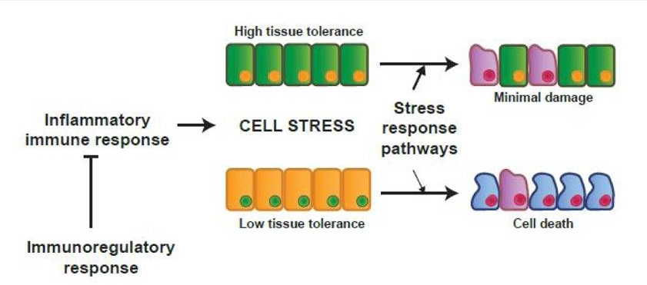
Background & Significance (2/5)
High tissue resilience
Target tissue resilience
regulates treatment response
Low tissue resilience
Promote GI tissue repair:
non-immunosuppressive
Wu Trends Immunol 2017

Slide 8
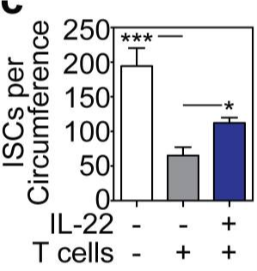
Background & Significance (3/5)
IL-22 receptor expressed on GI tissue epithelium and promotes cell survival
GVHD leads to loss of IL-22-producing host cells
IL-22 reversed loss of intestinal stem cells (ISCs) in established GVHD (murine model) (FIGURE)
F-652: recombinant fusion protein: human IL-22 dimer and IgG2 Fc, longer half-life than human IL-22
Phase 2 trial: 27 pts, GI GVHD (1-4), 4 weekly doses
Day 28 ORR: 70% (19/27); AA2/3 68% (13/19)
Lindemans Nature 2015, Ponce ASTCT 2020

Slide 9
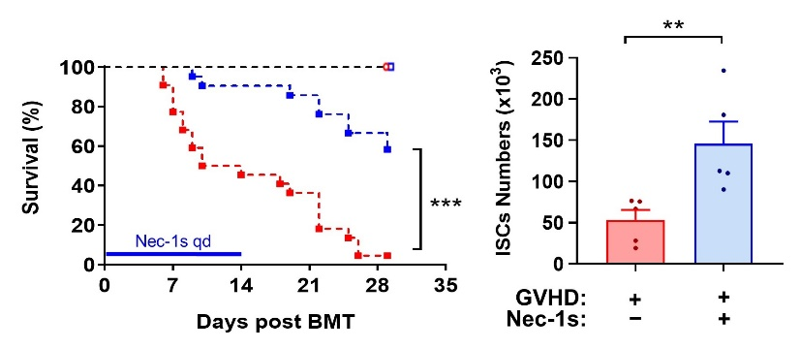
Background & Significance (4/5)
Cytokine inflammatory death mediated by RIPK1
Inhibition of RIPK1 by necrostatin-1s improves survival and protects ISCs in a murine GVHD model (FIGURE)
RIPK1 inhibitors in clinical trials for IBD
Ferrara lab, unpublished data

Slide 10
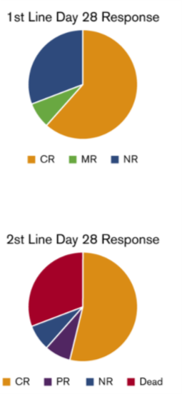
Background & Significance (5/5)
Epidermal growth factor (EGF) promotes epithelial repair
Protective in murine IBD model
Low EGF associated with severe GI GVHD
HCG promotes tolerance
Pregnyl (uHCG, contains EGF)
Phase 1 study: 13 Minn HR patients, 13 SR GVHD
Every other day SQ dosing x 7 days, then 2x/wk
1st line: CR 62%, SR GVHD: CR 54%
FDA granted orphan drug designation
62%
54%
Holtan Blood Adv 2020

Slide 11
Trial Design
Platform: randomized phase 2 studies
suitable for introducing new agents, moving best to phase III
Key inclusion criteria: enrich for high risk GVHD (i.e., grade II-IV/Ann Arbor 2/3)
High risk population: 35% of GVHD
Steroids + investigational agent
Primary endpoint: D28 ORR, secondary: duration of response, NRM, relapse, OS, toxicities
15% improvement in ORR (57% to 72%) would be meaningful

Slide 12
Feasibility & Logistics
Real-time biomarker screening is feasible (BMT CTN, MAGIC)
High risk biomarkers 35% of patients (screen 3, enroll 1); Minn HR 15% (screen 6, enroll 1)
Successful phase 2 trials can sequence into phase 3 trials
Requires collaboration with industry partners to gain access to agents
Phase II
Phase III
F652 (IL22 agonist)
winner
Randomize
Randomize
RIPK1 inhibitor
soc
Conduct 2 parallel arms (n=68 per arm, total n=136), advance agent(s) if ORR ≥ 69%. Phase 2 power 95%, alpha = 0.028.

Slide 13
External Review & Online Feedback
In general, enthusiasm for BM-based enrichment strategy
Cellular therapies (T-regs, MSCs) are other options
Low enthusiasm for inhibition of T-cell trafficking to GI tract (dropped from presentation)
Microbiome manipulation is another strategy to consider

Slide 14
Low Risk GVHD: Hypothesis
Decreased exposure to systemic steroid treatment will reduce morbidity in patients with LR GVHD
Importance to Field:
Consensus guidelines recommend high cumulative steroid tx even for responding patients (20-40 mg/kg during first 4 weeks)
MAGIC data confirms high cumulative steroid exposure (27 mg/kg) in LR pts
High dose steroid tx leads to infections, organ toxicities, and poor QOL
Martin BBMT 2012

Slide 15
Background & Significance (1/2)
Steroid treatment is toxic with short and long-term effects
Infections (esp viral), reduced QOL, diabetes, muscle/bone damage, neuropsychiatric effects
Impact worse for children, adolescents and older adults
Risk of steroid treatment decreases utilization of HCT in older adults
Physicians prescribe high doses of steroids because they cannot predict whether responses will be sustained during tapers
BMT CTN 1501: sirolimus monotherapy as effective as steroids, but ↑TMA, unsustained responses
75
p=0.003
Percent
50
25
0
Topical
Systemic
Serious viral infections in Minn SR GVHD patients treated with topical steroids (blue, n=69) or systemic steroids (pink, n=108)
Matsumura-Kimoto BBMT 2016, Rosen Pediatr Rev 2019, Waljee BMJ 2017, Zuckerman Blood 2017, Mielcarek Haematologica 2015

Slide 16
Background & Significance (2/2)
Low risk GVHD can be identified at onset by clinical (Minn std risk) and biomarker criteria (AA1)
60% of all GVHD
Current practice: response to steroid treatment: 81%, NRM 5%
Non steroid treatment feasible (sirolimus); other options include JAK inhibitors
MAGIC algorithm validated as treatment response biomarker
Serial monitoring for two weeks by clinical and biomarker response identifies a large subset of “ultra-low risk” patients with exceptional outcomes
Response rate: 91%, NRM 2%
Ultra-low risk GVHD: 40% of all GVHD
Candidates for structured rapid steroid taper guided by continuous BM and clinical response with discontinuation (physiologic doses) in 4 weeks
Pidala Blood 2020, Srinagesh Blood Adv 2019, unpublished MAGIC data

Slide 17
Trial Design
Randomized phase 2 trial comparing steroid-free treatment to guided rapid steroid taper
Key inclusion criteria: Low risk GVHD that requires tx w/ steroids
Exclude grade I GVHD and isolated UGI GVHD
Endpoints: ORR, serious virus infections, PROs, cumulative steroid dose, time to d/c of IST

Slide 18
Feasibility & Logistics
Real-time biomarker screening is feasible (BMT CTN, MAGIC)
Low risk GVHD:
60% of all GVHD, large numbers of patients available for screening
Guided tapers:
Poor adherence to “recommended” steroid tapers
inform centers of weekly steroid dose based on clinical and BM results for better adherence
BMT CTN 1501 required 120 patients for randomized phase 2 (ORR endpoint)

Slide 19
External Review & Online Feedback
Reduction in steroid use is important
Some reviewers felt steroids are already tapered rapidly but multicenter data shows that rapid tapers are infrequent
Testing two “unknown” strategies at same time is problematic
Randomized phase 2 to move best options forward
Toxicity endpoints (e.g. infections or PROs) should be LR trial primary endpoints
No prophylaxis concepts
Prophylaxis is important but committee felt the greatest need was in treatment

Slide 20
Q&A Session

