Slide 1
Committee Hemoglobinopathies: Late Effects after HCT for Sickle Cell Disease
Mark Walters

Slide 2
Conflict of Interest Disclosure
Medical Director:
AllCells, Inc
Consultant:
Editas Medicine
Ensoma
Vertex

Slide 3
Committee Members
Committee Member | Center
Alistair Abraham | Children's National Medical Ctr
Sonali Chaudhury | Ann & Robert H Lurie Children’s/Northwestern
Courtney Fitzhugh | NIH
Helen Heslop | DCC Liaison
Tami John | Baylor/Texas Children's
Adetola Kassim | Vanderbilt
Laksmannan Krishnamurti | Emory/CHOA
Punam Mailik | Cincinnati Children's
Matt Porteus | Stanford/LPCH
Shalini Shenoy | Wash U/St. Louis Children's
Mark Walters | UCSF Benioff Children’s Oakland
Jesse Troy - biostats | Duke Univ

Slide 4
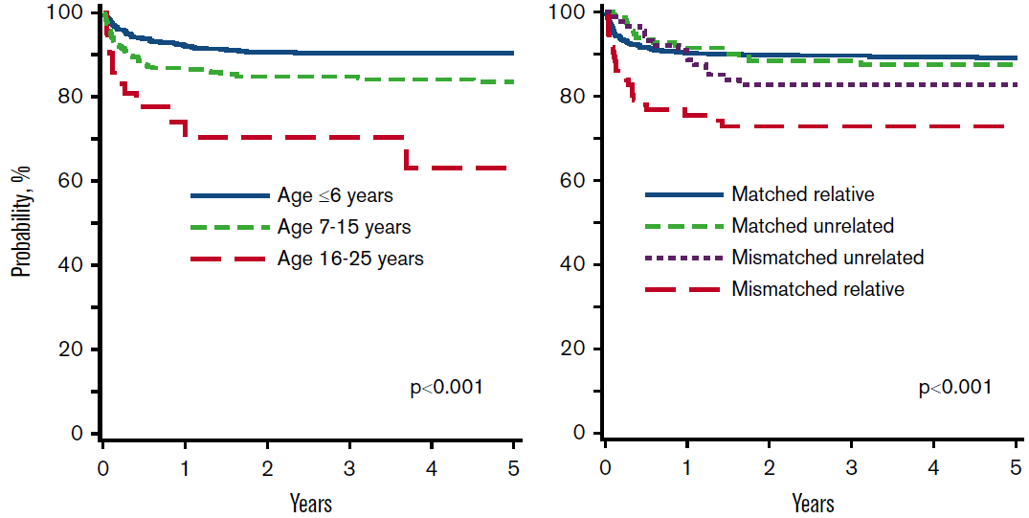
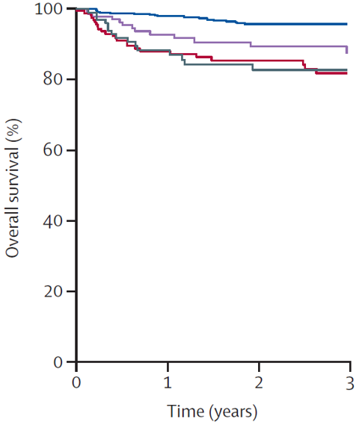

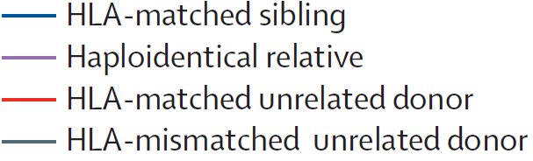
Allogeneic HSCT for Hemoglobinopathies
Overall survival by donor type
Transfusion-dependent β-thalassemia (TDT)¹ |  | Sickle cell disease (SCD)²
1. Li, et al. Blood Advances 2019; Eapen, et al. Lancet Hematol. 2019;6(11):e585-e596.

Slide 5
Lentiviral Gene therapy for SCD: Complete resolution of painful episodes
24m
HbA^{T87Q} stabilization†
24m
7
17
17
29
7
5
23
10
11
4
8
6
5
5
17
21
7
21
19
0
0
0
0
0
0
1
0
0
0
0
0
0
0
1
3
0
0
0
*
VOEs classified as severe VOEs
All other VOEs
N=19
Total number of events over 2 years pre-IC
Total number of events up to 2 years post-DP
24 Months Prior to Informed Consent
Post-LentiGlobin Follow-up (months)
5 (2.0–14.5)
0 (0–4.3)
Data as of 20 August 2020
5
Notes:
No VOEs* occurred after stabilization of HbA^{T87Q} expression† (last VOE at Day 22 post-LentiGlobin infusion)

Slide 6
Proposals in Hemoglobinopathies
Late Effects after HCT for Sickle Cell Disease
Comparison of curative therapies for 𝛃-hemoglobinopathies (e.g., novel genomic therapies and allogeneic HCT)
Unrelated donor HCT in Children with SCD
External reviewers ranked the proposals in this order of priority, with the most enthusiasm for the first proposal

Slide 7
External Review & Online Feedback
Strategy- 1 Highest priority- Given the pre-existing funding, this is a high priority.
Strategy-2 Low priority- constructing a multi-center natural history study of SCD is a challenging activity that requires a vast infrastructure and millions of dollars. In the new era of four FDA approved treatments for SCD and the pipeline of new therapies, the disease's clinical history will be changing. Cure SCi is setting up the tools for a contemporaneous comparison group that may allow for more efficient data extraction to follow large cohorts of children and adults with SCD.
Strategy 3- Not likely feasibile- the results on unrelated donor HCT are a distant third compared to MRD HSCT, haploidentical HSCT post-cyclophosphamide, or the potential benefit of gene therapy or gene editing. Except for the investigators with scientific interest in this area of research, very few hematologists would refer patients for unrelated HSCT.

Slide 8
Background & Significance
Pulmonary function after BMT (N=23)
Post-bmt Pulm function | Normal (N=9) | Obstructive (N=4) | Restrictive (N=10)
Unchanged | 7 | 1 | 3
Improved | N/A | 2 (normal in 2) | 6 (normal in 3)
More restrictive | 1 | - | 1
More obstructive | - | 1 | -
Mixed pattern (restrictive/obstructive) | 1 | - | -
Walters MC et al, BBMT, 16:263, 2010

Slide 9
Pulm function after Reduced Intensity preparation
BU, Flu, alemtuzumab before sibling BMT or UCBT (N=18)
11 of 13 patients had pre/post HCT PFTs at 2 years:
 | Pre-HCT | Post-HCT
FVC | 88±23.2% | 94.5±11.9%
FEV1 | 90±27.3% | 93.3±13.4%
Bhatia M et al BMT 49:213, 2014

Slide 10
Late Effects after HCT for Sickle Cell Disease: Hypothesis
Curative therapies (allogeneic HCT and autologous genomic therapies) halt disease-related clinical and subclinical events in SCD and thalassemia in target organs
These therapies also have the potential to cause treatment related-malignancies in SCD
What are the long-term effects of curative therapy in SCD (for example, in brain, heart, kidney, lungs)?
  What is baseline CHIP in SCD and risk of acute leukemia?

Slide 11
Despite LTFU guidelines in children and adults with SCD after curative therapy, no systematic approach undertaken to evaluate heart, lung or kidney disease
Assessment of heart, lung and kidney disease after curative therapy is considered standard care, but has not been routinely performed in most sites
COALESCE Cohort (U- award) will include only 5 sites to assess heart, lung and kidney disease and CHIP before and after curative therapy
  NIH, Johns Hopkins, Vanderbilt, DC Children, and Emory

Slide 12
LTFU after curative therapies for SCD
No funding is requested to expand into BMT CTN
  Support standard care guidelines in all BMT-CTN studies in SCD
  Provide enrollment credit for follow-up after curative therapy
  Provide a platform for presenting results to BMT-CTN community
Anticipated results
  Increased quality of care for children and adults after allogeneic HSCT and genomic therapies
  Allows for subgroup analysis to determine genetic and clinical risk factors for AEs after curative therapy in sickle cell disease

Slide 13
Comparison of STELLAR and COALESCE
Table 1: Differences Between Our Proposal and the STELLAR Late Effects Study. Participants in each study will be offered the opportunity to participate in the other study to expand patient participation and encourage scientific collaboration and efficiency.
Proposed Aims | STELLAR Aims
Impact of curative therapies on lung and kidney damage | Impact of curative therapies on patient reported outcomes and fertility
Impact of nonmyeloablative curative therapies on TRJV | Impact of curative therapies on immune reconstitution
Impact of curative therapies on CHIP | Evaluate association of curative therapies with financial toxicity

Slide 16
Risk of hematological malignancy in SCD
Assess for insertional mutagenesis in gene addition therapy by viral vectors
Consider the impact of ex-vivo manipulation of HSPCs in genomic therapies
Effect of busulfan/alkylator condition and previous HU exposures
Screening for high-risk clonal variants?
Post-transplant monitoring of clonal hematopoiesis

Slide 17
Feasibility & Logistics
Harmonize Enrollment and Data Collection Systems and Practices
to accommodate BMT-CTN Participation in STELLAR and COALESCE studies

Slide 18
Q&A Session

