Slide 1
Lymphoma:
Upfront CAR-T for high-risk mantle cell lymphoma
Consolidation for CAR-T incomplete responders in Diffuse Large B Cell Lymphoma
Frederick L. Locke, MD

Slide 2
Conflict of Interest Disclosure
Frederick L. Locke:
Scientific Advisory Role: Allogene, Amgen, Bluebird Bio, BMS/Celgene, Cellular BioMedicine Group Inc, Calibr, GammaDelta Therapeutics, Iovance, Janssen, Legend Biotech, Novartis, Wugen
Research Funding: Kite Pharma (Institutional), Allogene (Institutional), Novartis (Institutional)
Unlicensed patents in the filed of Cellular Immunotherapy.

Slide 3
Committee Members
Committee Chair | Frederick L. Locke, MD | Moffitt Cancer Center
 | Sairah Ahmed, MD | MD Anderson Cancer Center
 | Farrukh Awan, MD | University of Texas Southwestern
Study Design Cmte. Rep. | Amer M. Beitinjaneh, MD | University of Miami
 | Elizabeth Budde, MD, PhD | City of Hope
 | Nilanjan Ghosh, MD, PhD | Levine Cancer Institute
Data Center Liaison | Mehdi Hamadani, MD | Medical College of Wisconsin
 | Brian Hill, MD, PhD | Cleveland Clinic
 | Matthew Lunning, DO | University of Nebraska Medical Center
 | David G. Maloney, MD, PhD | Fred Hutch
 | Craig Sauter, MD | Memorial Sloan-Kettering Cancer Center
 | Patrick Stiff, MD | Loyola University Medical Center
 | Jakub Svoboda, MD | University of Pennsylvania

Slide 4
Proposed Study Concepts
Upfront CAR-T for high-risk mantle cell lymphoma
Autologous Transplantation in CD30+ Peripheral T-cell Lymphoma
Consolidation for CAR-T incomplete responders in Diffuse Large B Cell Lymphoma (DLBCL)
Improving outcomes in partially chemo-responsive relapsed/refractory DLBCL

Slide 5
Proposed Study Concepts
Upfront CAR-T for high-risk mantle cell lymphoma
Autologous Transplantation in CD30+ Peripheral T-cell Lymphoma
Consolidation for CAR-T incomplete responders in Diffuse Large B Cell Lymphoma (DLBCL)
Improving outcomes in partially chemo-responsive relapsed/refractory DLBCL

Slide 6
Upfront CAR-T for high-risk mantle cell lymphoma (MCL)
Hypothesis:
CD19 chimeric antigen receptor T cell therapy (CAR-T) as frontline, after lead-in immunotherapy, will safely improve progression-free survival (PFS) in ultra-high-risk (UHR) MCL.

Slide 7
Upfront CAR-T for high-risk mantle cell lymphoma (MCL)
Hypothesis:
CD19 chimeric antigen receptor T cell therapy (CAR-T) as frontline, after lead-in immunotherapy, will safely improve progression-free survival (PFS) in ultra-high-risk (UHR) MCL.
Trial Concept:
Phase II trial of CAR-T after novel BTKi-based lead-in as frontline therapy for ultra-high-risk (UHR) MCL.

Slide 8
Background & Significance
2-year PFS ranges from 20-50% in MCL patients with adverse-risk features¹:
High International Prognostic Index (MIPI) and high-intermediate/high MIPI-c
2-year PFS 30-50% ²
TP53 mutation
2-year PFS 20% ³
Chromosomal 17p deletions
2-year PFS 50% ³
Complex karyotype
2-year PFS 45% ⁴
Blastoid histology
2-year PFS 45% ²
Notes:
Even with novel agents, adverse features still denotes poor prognosis (1. Maddocks. Blood 2019)
high MCL International Prognostic Index (MIPI) or MIPI-c (2. Hoster E. JCO. 2016) high-intermediate/ high MIPI-c 2-year PFS 30-50%
high proliferation index (e.g. Ki-67 >30%) (Hoster E. JCO. 2016) 2 yr PFS 50%
presence of TP53 mutation (3. Eskelund C. Blood 2017) 2-year PFS 20%
chromosome 17p deletions (Eskelund C. Blood 2017) 2 yr PFS 50%
complex karyotype (4. Greenwell I. Cancer. 2018) 2-year PFS 45%
blastoid histology (Hoster E. JCO. 2016) 2 yr PFS 45%
Even in the era of novel agents, or with consolidative ASCT, these patients fare poorly. In particular, many clinicians no longer offer ASCT for TP53 mutated patients given dismal OS outcomes for these patients (median OS ~2years). Clearly this represents an UNMET need.

Slide 9
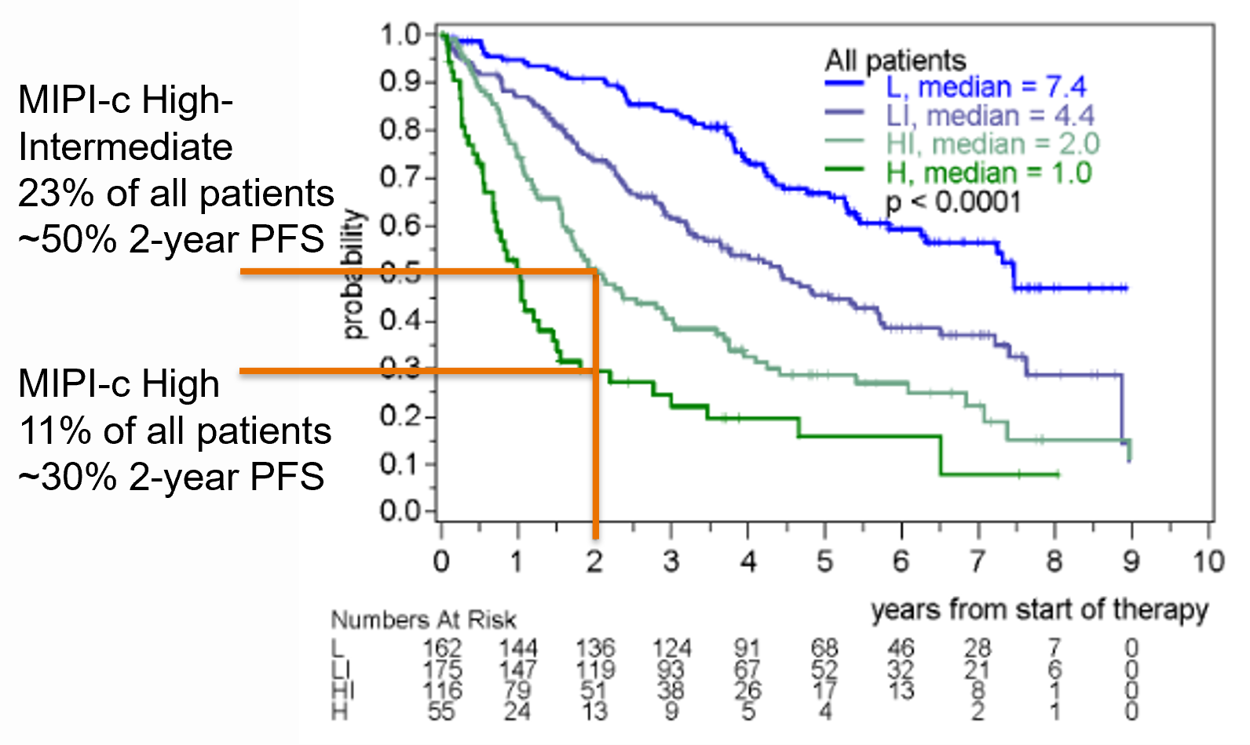
Background & Significance
2-year PFS ranges from 20-50% in MCL patients with adverse-risk features¹:
High International Prognostic Index (MIPI) and high-intermediate/high MIPI-c
2-year PFS 30-50% ²
TP53 mutation
2-year PFS 20% ³
Chromosomal 17p deletions
2-year PFS 50% ³
Complex karyotype
2-year PFS 45% ⁴
Blastoid histology
2-year PFS 45% ²
Notes:
Even with novel agents, adverse features still denotes poor prognosis (1. Maddocks. Blood 2019)
high MCL International Prognostic Index (MIPI) or MIPI-c (2. Hoster E. JCO. 2016) high-intermediate/ high MIPI-c 2-year PFS 30-50%
high proliferation index (e.g. Ki-67 >30%) (Hoster E. JCO. 2016) 2 yr PFS 50%
presence of TP53 mutation (3. Eskelund C. Blood 2017) 2-year PFS 20%
chromosome 17p deletions (Eskelund C. Blood 2017) 2 yr PFS 50%
complex karyotype (4. Greenwell I. Cancer. 2018) 2-year PFS 45%
blastoid histology (Hoster E. JCO. 2016) 2 yr PFS 45%
Even in the era of novel agents, or with consolidative ASCT, these patients fare poorly. In particular, many clinicians no longer offer ASCT for TP53 mutated patients given dismal OS outcomes for these patients (median OS ~2years). Clearly this represents an UNMET need.

Slide 10
Background & Significance
2-year PFS ranges from 20-50% in MCL patients with adverse-risk features¹:
High International Prognostic Index (MIPI) and high-intermediate/high MIPI-c
2-year PFS 30-50% ²
TP53 mutation
2-year PFS 20% ³
Chromosomal 17p deletions
2-year PFS 50% ³
Complex karyotype
2-year PFS 45% ⁴
Blastoid histology
2-year PFS 45% ²
Newly diagnosed MCL patients w/ ultra- high-risk features have dismal outcomes
New therapies and approaches are desperately needed to improve outcomes
Notes:
Even with novel agents, adverse features still denotes poor prognosis (1. Maddocks. Blood 2019)
high MCL International Prognostic Index (MIPI) or MIPI-c (2. Hoster E. JCO. 2016) high-intermediate/ high MIPI-c 2-year PFS 30-50%
high proliferation index (e.g. Ki-67 >30%) (Hoster E. JCO. 2016) 2 yr PFS 50%
presence of TP53 mutation (3. Eskelund C. Blood 2017) 2-year PFS 20%
chromosome 17p deletions (Eskelund C. Blood 2017) 2 yr PFS 50%
complex karyotype (4. Greenwell I. Cancer. 2018) 2-year PFS 45%
blastoid histology (Hoster E. JCO. 2016) 2 yr PFS 45%
Even in the era of novel agents, or with consolidative ASCT, these patients fare poorly. In particular, many clinicians no longer offer ASCT for TP53 mutated patients given dismal OS outcomes for these patients (median OS ~2years). Clearly this represents an UNMET need.

Slide 11
Background & Significance
Brexucabtagene autoleucel CD19-CAR-T demonstrated remarkable efficacy in refractory MCL patients that previously received BTKi.
92% ORR
67% CR
61% 12-month PFS
59% 15-month PFS
Notes:
Patients with R/R MCL who progress after BTKi therapy have poor clinical outcomes. The expected ORR 25-42%, and OS is 6-10 months with salvage therapies.
At a median f/u of 17.5 mo, in 60 evaluable patients.
Ongoing response rate did not differ in patinets with TP53 mutations 6/30 (20%); hi Ki67 >30% n=40; Blastoid (n=14) vs Classical; n=35
Early results in patients treated with lisocabtagene maraleucel suggest similar outcomes

Slide 12
Trial Design
Single arm phase II trial for UHR MCL evaluating front-line CD19-CAR-T after lead-in of BTKi+/-rituximab.
Before enrollment, <=2 standard induction cycles are permitted.
Primary endpoint: 2-year PFS from enrollment.
Secondary endpoints: Adverse events; OS; ORR; Achievement of MRD; Apheresis and CAR-T phenotype; CAR-T levels in the blood
High-risk MCL Registered after meeting study eligibility
Apheresis +/- bridging
Flu/Cy LD
CAR-T
Follow up:
Relapse/progression
MRD monitoring
BTKi +/- rituximab 4 – 6 cycles
Notes:
Given patients may be responding following 2 cycles thereby confounding results of this as a frontline regimen, may consider an alternate design allowing only one prior cycle of induction.

Slide 13
Trial Design: Options or Alternatives
For consideration:
Patients with MRD receive BTKi maintenance.
Alternative Designs:
Randomized phase II against best available care in frontline
CAR-T consolidation following standard induction as a phase 2 and then compared in a randomized phase III against induction followed by ASCT in responders.
Notes:
Give rationale for single arm phase 2. Issue with randomized trial, do we really want to take to auto. BTKi maintenance: Idea is to look at CAR T in isolation. BTKi maintenance may cloud outcomes. Must have industry sponsorship: IF can get indication by a single arm Phase 2 trial.. Must have an FDA discussion regarding registration (May require Randomized Phase 3, May not). Consider 1 cycle only of upfront therapy.

Slide 14
Feasibility & Logistics
2-year PFS, based upon historical controls, is estimated to be 45%
We estimate this approach could increase 2-year PFS to 65%
54 patients are needed to detect 20% improvement, with 90% power and one-sided 0.05 alpha for an exact-binomial test.
For interim monitoring, sample size is inflated to 60.
18-month accrual and 24-month follow-up is estimated.
CAR-T manufacturer support is required: several are interested to pursue upfront MCL indications.
BTKi may garner industry support given the crowded market.

Slide 15
External Review & Online Feedback
External Expert Reviewers:
Reviewer #1
[This is] an area of significant unmet need. The key will be an appropriate definition of high risk. Could definitely change practice and would need a network to complete a trial like this.
In theory, industry could do a trial like this, so that would be the only weakness.

Slide 16
External Review & Online Feedback
External Expert Reviewers:
Reviewer #2
This is a very important question, as we now can better define high risk MCL, and we know that standard therapy is not adequate in this situation.
My major concern with the proposed design is the single arm nature of this proposal. In CLL, high risk predictive markers in the setting of chemoimmunotherapy do not hold when novel agents such as BTK inhibitors are utilized. The same situation could be true for MCL.
ECOG as well as the German Mantle Cell Consortium are studying non chemotherapy regimens in this setting. I would strongly endorse a randomized design where CAR-T is one arm, and the other arm would include other alternatives to chemotherapy.
The other issue with this trial is that the majority of patients with high risk mantle cell lymphoma are older and may not be eligible for CAR-T.

Slide 17
External Review & Online Feedback
Online Feedback:
I think bifunctional antibodies are going to be cheaper, easier, and at least as effective as CART - why not go with mosunetuzumab or RGN 1979 instead and CART if it fails
Patient specific CAR T products may be replaced by allo products so this is modest set of proposals
The concept of bringing CAR T into the frontline therapy of high risk MCL is clinically very interesting.
Concerns would be if the patients develop prolonged cytopenias after CAR T - would this affect collection ability at later time point ?
It may be more reasonable to do MCL CAR T cell therapy as true second line instead of salvage plus auto, similar as this is being done for JCAR 17 for DLBCL.

Slide 18
External Review & Online Feedback
Online Feedback (Continued):
Could be improved either by randomization or change the primary endpoint to CR rate. PFS in single arm is non interpretable
[The] Concept is good but needs a strong comparison group - eg concurrent controls from eg the CIBMTR database or other database

Slide 19
Consolidation for CAR-T incomplete responders in Diffuse Large B Cell Lymphoma (DLBCL)
Hypothesis:
Consolidation therapy will improve PFS for DLBCL patients at high risk for progression following first disease assessment after CAR-T.

Slide 20
Consolidation for CAR-T incomplete responders in Diffuse Large B Cell Lymphoma (DLBCL)
Hypothesis:
Consolidation therapy will improve PFS for DLBCL patients at high risk for progression following first disease assessment after CAR-T.
Trial Concept:
A randomized trial evaluating immunotherapy consolidation in DLBCL with stable disease (SD) or partial remission (PR) on first imaging after CD19-CAR-T.

Slide 21
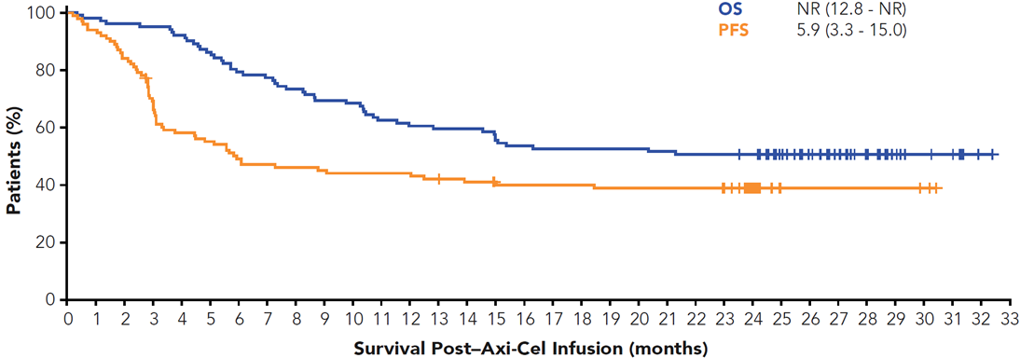
Background & Significance
Autologous CD19 directed CAR-T cell therapy leads to remarkable durable response rates in relapsed and refractory DLBCL.
The majority of patients progress after CAR-T.

Slide 22
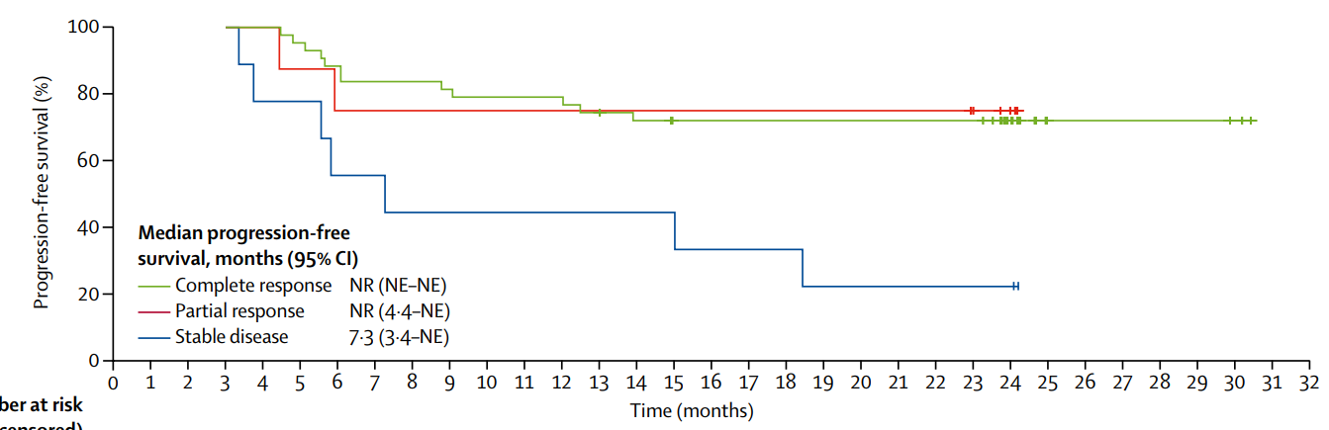
Background & Significance
Responses are highly dynamic in the first 90 days after CAR-T.
Ongoing response at day 90 is associated with durable response beyond 1 year.

Slide 23
Background & Significance
65-75% of DLBCL patients with PR, and 90-95% with SD, on day+28 PET-CT scan after CAR-T will ultimately progress by 1-year.¹⁻⁴
This group comprises ~40% of CAR-T patients and as responses can deepen, observation is the current standard.
Neelapu SS, NEJM 2017
Schuster S, NEJM 2019
Abramson JS, Lancet 2021
Nastoupil L, JCO 2020

Slide 24
Background & Significance
65-75% of DLBCL patients with PR, and 90-95% with SD, on day+28 PET-CT scan after CAR-T will ultimately progress by 1-year.¹⁻⁴
This group comprises ~40% of CAR-T patients and as responses can deepen, observation is the current standard.
MRD monitoring at day+28 may identify those destined to progress.⁵
Neelapu SS, NEJM 2017
Schuster S, NEJM 2019
Abramson JS, Lancet 2021
Nastoupil L, JCO 2020
Hossain NM, ASH 2019 #609

Slide 25
Trial Design
Phase II randomized 3-arm study evaluates 6-months of tafasitamab+ lenalidomide or polotuzumab+ mosunetuzumab*, compared to observation, for incomplete responders to commercial CAR-T at Day+28 by PET-CT.
Patients are randomized following the day+28 PET.
Primary endpoint: 1-year PFS after randomization.
Secondary endpoints: CR rate, OS, MRD assay progression predictability, and CAR-T persistence.
An alternate design may allow enrollment prior to day+28, and patients achieving CR are monitored for MRD.
*Alternative agents and combinations could be considered.
Notes:
Do not overemphasize the intervention. Rationale Novel therapies should be considered.

Slide 26
Feasibility & Logistics
After CD19-CAR-T, 5% of SD and 30% of PR patients at day+28 will be in remission at day+90, and only 75% of those will persist at 1 year.
57 patients per arm must be randomized to detect an increase in aggregate 1-year PFS from 20% to 40% using Fisher’s Exact test with 80% power and a one-sided 10% alpha for each comparison against the standard arm.
Patients relapsing after CAR-T have dismal outcomes and pharmaceutical companies are enthusiastic to demonstrate efficacy in this population.

Slide 27
External Review & Online Feedback
External Expert Reviewers:
Reviewer #1
[An] area of high unmet need and I think it would be well received at academic sites. Several good interventions that could be contemplated. Would enroll well.
Reviewer #2
This is a very important area and has direct potential to change practice.
Given the rarity of this scenario, it would require a multicenter network study to be done effectively.
There are current discussions about this approach in the NCTN.
… to succeed, it will be important to have broad by-in on the experimental arms.

Slide 28
External Review & Online Feedback
Online Feedback :
The concept is certainly meaningful and already being practiced off label at different places, often trying lenalidomide or check point inhibitor off label if approved and paid for.
Would there be concerns with tolerability - especially from a marrow suppressive point of view for the tafa/rev arm?
polotuzumab+ mosunetuzumab - not sure if this is approved already in this combination and if this has been shown to be safe, study design would depend on this

Slide 29
Q&A Session

