Slide 1
Myeloid Malignancies Committee:
Prediction and Biology of AML Relapse after HCT
Prevention and Treatment of Relapse of AML after HCT
Yi-Bin Chen, MD

Slide 2
Conflict of Interest Disclosure
Consulting:
  Magenta
  Incyte
Data Safety Monitoring Committees:
  Abbvie
  Daiichi
  Celularity
  Equilium
  Actinium

Slide 3
Committee Members
Committee Member | Center
Nelli Bejanyan | Moffitt
Yi-Bin Chen (Chair) | MGH
Steve Devine | NMDP
Aaron Gerds | Cleveland Clinic
Saar Gill | UPenn
Mike Grunwald | Levine
Chris Hourigan | NHLBI
Rich Little | NCI
Coleman Lindsley | DFCI
Mark Litzow | Mayo
Lori Muffly | Stanford
Wael Saber | MCW
Brian Shaffer (Clinical Trials Committee) | MSKCC
Bart Scott | Fred Hutch
Sumi Vasu | OSU

Slide 4
Proposed Study Concepts
Prediction and Biology of AML Relapse after HCT
Phase II Platform Trial of Maintenance Therapy for High-Risk AML
Phase II Platform Trial of Maintenance Therapy for p53 Mutated Myeloid Malignancies
CIML-NK Cells to Treat Post-HCT Myeloid Relapse*
Phase III RIC vs MAC for MRD negative AML in CR1
Maintenance Therapy with IDH Inhibitors / other Targeted Rx
Addition of Antibody-based Conjugates to Conditioning
Refinement of MDS Therapy Prior to HCT
HCT Approaches for Primary Refractory AML
* Denotes concept developed by Pediatric committee

Slide 5
Molecular Evaluation of AML patients after Stem cell transplant to Understand Relapse Events: Hypothesis
Hypothesis:
1. Serial blood AML MRD monitoring by DNA-sequencing post-HCT will have superior ability to predict relapse than pre-HCT assessment.
2. Collection of post-HCT relapse samples will allow quantification of leukemic clonal selection versus immunological escape as mechanisms of HCT failure.
Objective: To optimize methods, optimal timepoints and technical workflow for MRD testing in a prospective cohort.

Slide 6
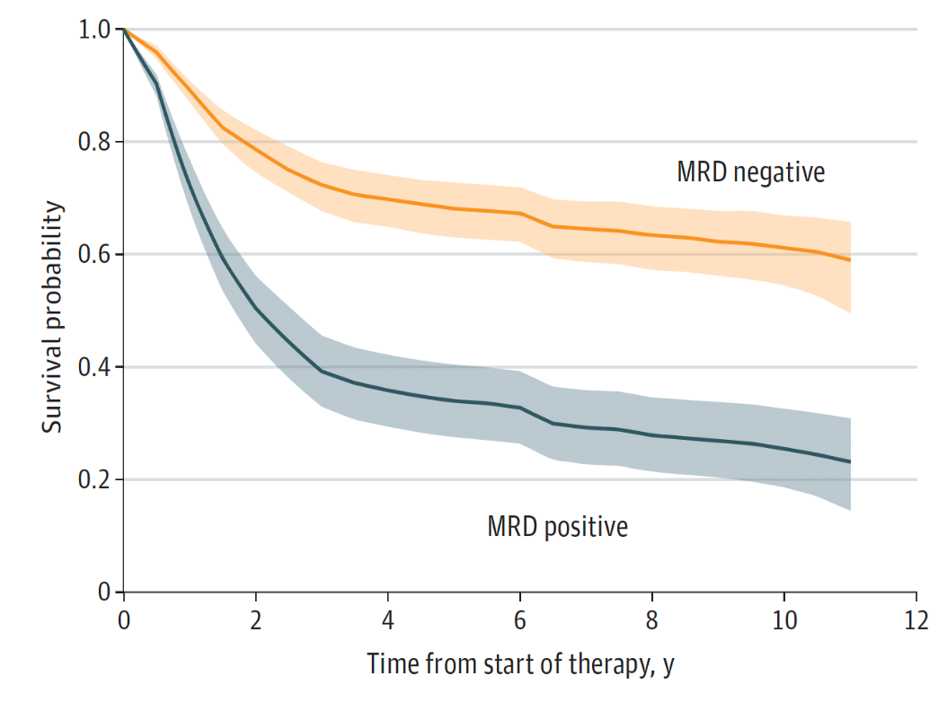
Background & Significance
Relapse of AML, even for those entering alloHCT in cytomorphological CR, is the most common form of post-AlloHCT treatment failure and death.
Detectable measurable residual disease (MRD) has been shown in AML patients in CR to be associated with higher relapse and lower survival.
Problem: AML MRD testing is not standardized, and no clear path to translate findings from research laboratories to clinical transplant settings currently exists.
Overall Survival, stratified by MRD status
Short et al., JAMA Oncology 2020

Slide 7
Protocol Design
1000 adult AML patients undergoing AlloHCT in CR
Sample collection timepoints:
DNA: Diagnosis, Pre-HCT, donor, Post-HCT: qMo x6 then 9,12,15,18 mo
Cells: Pre-HCT, 3mo, relapse
Data: CIBMTR CRF Track

Slide 8
Feasibility & Logistics
An analogous prospective multi-center protocol, BMT-CTN 1202, for evaluation of biomarkers predictive of complications and mortality following alloHCT recently successfully enrolled 1860 participants with 8 biospecimen timepoints in the first 90 days after transplant.
Estimated accrual 2022 – 2025
Co-enrollment on other protocols allowed / encouraged
NMDP will be using funds from Office of Naval Research grant to support this in part

Slide 9
External Review & Online Feedback
Peripheral blood vs bone marrow sampling effecting feasibility
  Serial bone marrow sampling may yield more information on both MRD and relapse biology, but obviously more difficult to obtain
Method of MRD analysis: MFC vs NGS
Uncertainty of accessing diagnostic bone marrow
Real-time result availability
Limited resources / appetite for another biospecimen collection study

Slide 10
Platform AML Maintenance Trial: Hypothesis
Maintenance therapy after HCT for adverse risk AML in CR1 can lower the risk of relapse

Slide 11
Background & Significance
Disease relapse remains the leading cause of death after HCT for patients with AML
Patients at high risk for disease relapse can be identified by certain features at diagnosis
Novel agents with less off-target toxicity may be able to be safely given as maintenance therapy after HCT
No single agent has yet shown compelling efficacy in this setting to warrant testing in a phase 3 trial

Slide 12

Trial Design
Cellular Rx
Drug X
AML
Morphological CR1 (AML)
Adverse risk as defined by 2017 European LeukemiaNet
MAC or RIC HCT
PLATFORM
Drug Y
BiTE / DART

Slide 13
Feasibility & Logistics
Accommodate multiple open-label phase II studies testing several novel interventions / agents
Common screening / registration process
Anticipate 1-year PFS to be approximately 55% in this high-risk population
  Sufficient power to detect a 15% difference (70% 1-year PFS) may be achieved with approximately 71 patients per study
Provides the groundwork for future phase III study

Slide 14
External Review & Online Feedback
Limited availability of suitable agents
Appropriate early phase trials for candidate agents need to be done to identify dose / safety issues
Inclusion of intermediate / good risk patients as well
How to incorporate MRD into framework / endpoints
Ability to separate specific genotypes into cohorts

Slide 15
CIML-NK Cells to Treat Post-HCT Relapse: Hypothesis
Cytokine-Induced Memory-Like NK (CIML NK) cells can safely and effectively treat relapse of myeloid malignancies in post-HCT pediatric patients
Pediatric SOSS CATCH-Trial Committee:
Leslie Kean, MD, PhD
Rizwan Romee, MD,
Susanne Baumeister, MD
Roman Shapiro, MD
Rachel Phelan, MD
Vicky Vu, PhD

Slide 16
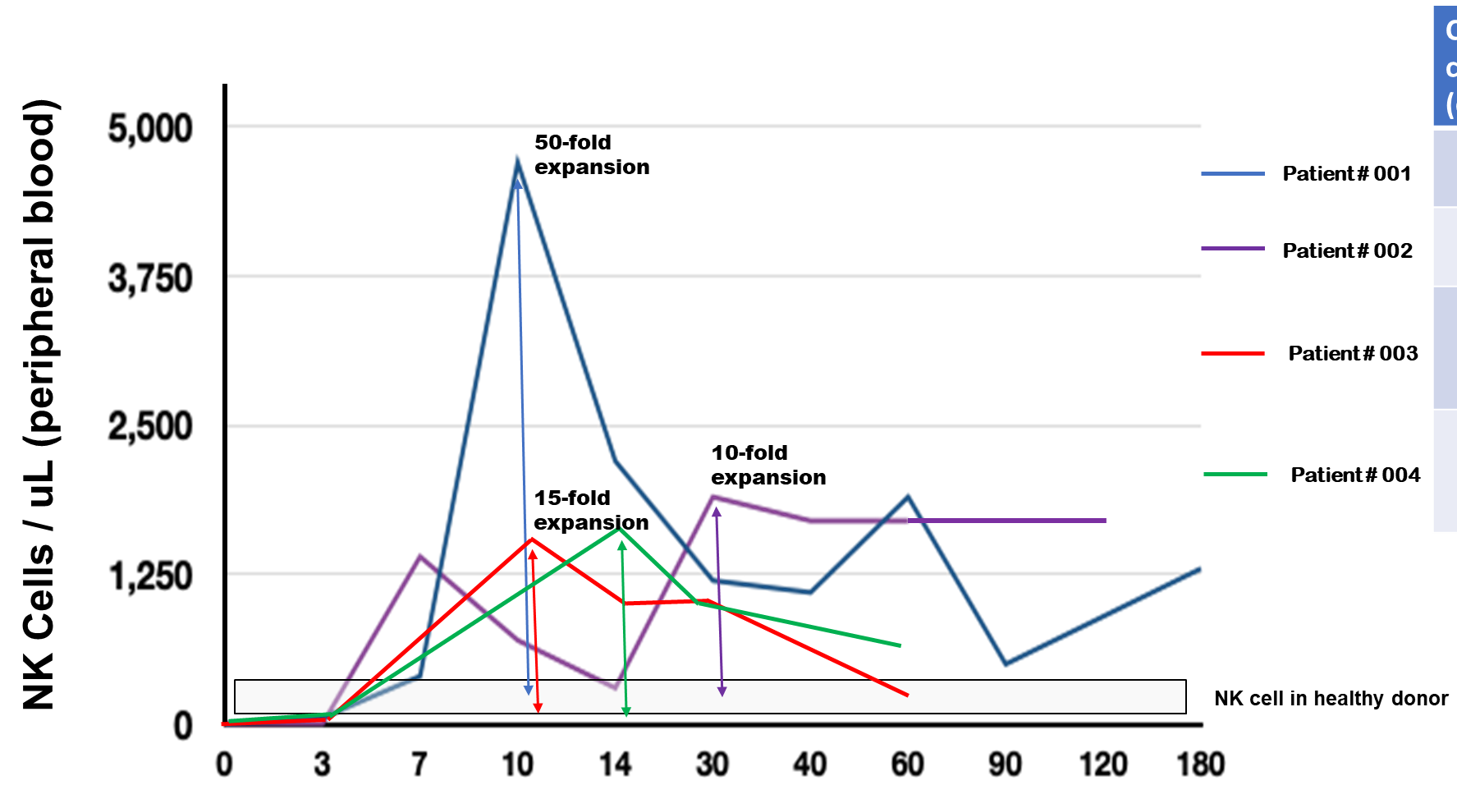
Background & Significance
Short-term culture of conventional NK cells in IL-12, IL-15, IL-18 induced ‘CIML-NK’ cells is characterized by:
Enhanced tumor killing in vitro and vivo
Enhanced ADCC
Action independent of HLA-KIR interaction
Potential inhibition of GVHD-inducing alloreactive T cells
Enhanced proliferation
Prolonged in vivo persistence
Efficacy, expansion and prolonged NK cell persistence observed in early Phase adult trials
In vivo expansion and persistence of CIML NK cells in DFCI’s post transplant relapse trial
Days Post CIML-NK Cell Infusion
Romee et al, Blood 2012
Romee et al, Science TM 2016
Shapiro et al, ASH 2020, Abstract 66

Slide 17
Trial Design
Primary Phase 1 Objective:
Safety and Feasibility of CIML-NK with IL-2 after HCT for relapsed AML
Primary Phase 2 Objective:
Safety data and preliminary data on efficacy inducing CR and improving OS after HCT relapse
Secondary Objectives for Both Phases:
CR/Cri rates and detectability of MRD at d+28
Rate of LFS and OS at d+100 and 1year
Incidence and severity of acute GVHD at d+100 and 6months
Incidence and severity of chronic GVHD at 1year

Slide 18
Feasibility & Logistics
Trial presents a critical step forward in bringing NK-based therapies to pediatric patients in a multi-center setting
Current multicenter PTCTC CD33-CART trial supports feasibility
Feasibility data will be essential for planning a larger multicenter Phase 2 trial
CIML NK-cells currently need to be cultured and infused fresh
    Enrollment will be limited to centers with cGMP capabilities, which exist at a large number of participating pediatric centers
    Translational efforts to refine methodologies for cryopreservation will be implemented when optimized

Slide 19
External Review & Online Feedback
Evidence of CIML-NK persistence after infusion and role of low-dose IL-2 (on persistence, function and Tregs) ?
Lymphodepletion regardless of ALC/T-cell counts post HCT?
Role of KIR-receptor/ligand mismatch?
Logistic constraints, particularly during pandemic
Competition for the very high-risk patients from other studies?
Patient selection: Include MRD+ vs full marrow relapse, JMML after first post-HCT relapse?

Slide 20
Q&A Session

