Slide 1
Committee Nonmalignant:
Upfront Alternative Donor BMT for
Severe Aplastic Anemia
Amy E. DeZern, MD, MHS
Johns Hopkins

Slide 2
Conflict of Interest Disclosure
None related to this presentation

Slide 3
Committee Members
Committee Member | Center
Suneet Agarwal, MD, PhD | Boston Children’s Hospital/ Harvard
Jaap-Jan Boelens, MD, PhD | Memorial Sloan Kettering
Jane Churpek, MD | University of Wisconsin
Amy DeZern*, MD, MHS | Johns Hopkins
Chris Dvorak, MD | UCSF Benioff Children’s Hospital
Mary Eapen**, MRCPI, MS, MBBS | Medical College of Wisconsin
Nancy Geller, PhD | National Heart, Lung, and Blood Institute
George Georges, MD | Fred Hutchinson
Lucy Godley, MD, PhD | University of Chicago
Jennifer Kanakry, MD | National Cancer Institute
Margaret McMillan, MD, MSc | University of Minnesota
Anu Narla, MD | Stanford
Ghadir Sasa, MD | Texas Children’s

Slide 4
Proposed Study Concepts
Strategy 1. HCT for primary immune regulatory disorders
Strategy 2. Upfront Alternative Donor BMT for SAA
Strategy 3. Radiation/alkylator-free HCT for TBDs

Slide 5
Hematopoietic reconstitution for adults with treatment-naïve SAA
Hypothesis
Optimizing the conditioning regimen for upfront BMT for adults with SAA will result in improved cure, regardless of age and donor

Slide 6
Background & Significance
IST is standard front-line treatment for SAA¹
except for patients aged <25 years with a suitable MSD¹
Hematopoietic response after IST is ~ 70%-80%
5-year survival ~60%-85%^{1,2}
Post IST failure-free survival ~10 years ~50%^{3,4}
Alive/ remission without clonal disease
Long-term survival after BMT
~ 90% in patients aged < 20 years ⁵
~ 75% >20 years ⁵
BMT with an unrelated or haplo related donor reserved after failure of IST^{6,7}
PTCy has improved the safety/ efficacy of alternative donor BMT ^{8,9}
1. N Engl J Med 2017;376:1540-50. 2. Blood 2012;120:1185-96. 3. Blood 2011;117:4434-41. 4. N Engl J Med 2011;365:430-8. 5. CIBMTR Summary Slides 2013. 6. Bone Marrow Transplant 2013;48:183-5. 7. Hematol Oncol Clin North Am 2018;32:629-42. 8. BiolBlood Marrow Transplant 2008;14:641-50. 9.Biol Blood Marrow Transplant 2017;23:498-504.

Slide 7
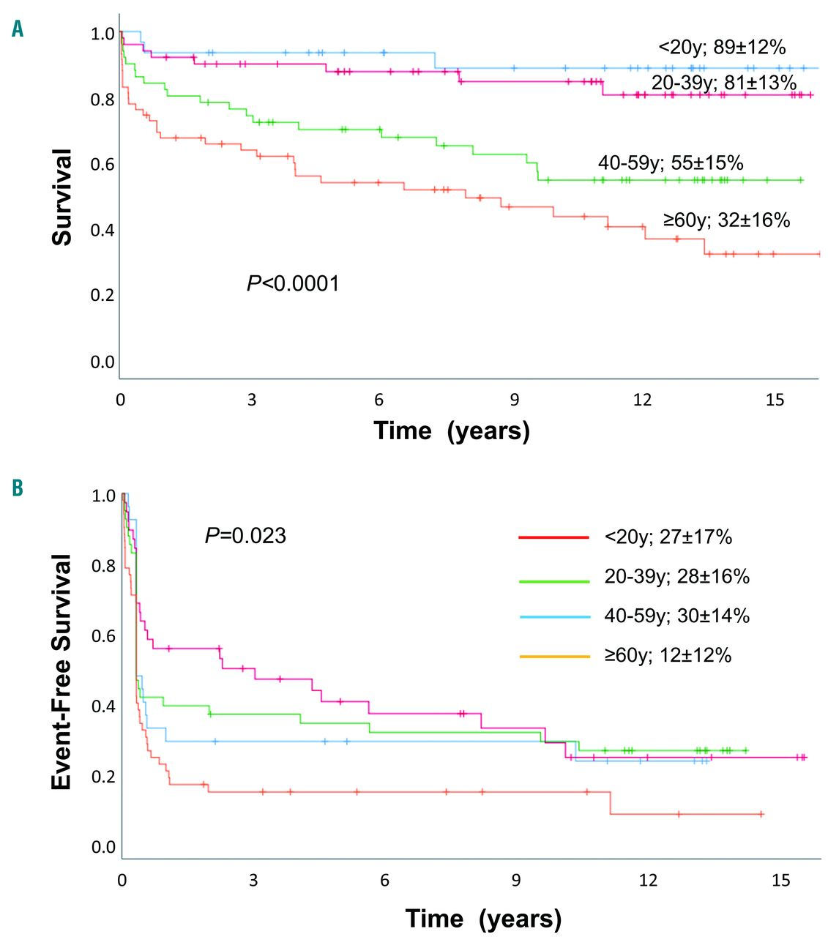
Outcomes in adults post IST
Long term follow up of patients treated with h ATG +CsA (+/- GCSF)
Median follow-up 11.7 years (95% CI, 10.9-12.5).
OS 15 years was 60%
EFS 23%
Events included relapse, non-response at day 120, subsequent BMT, MDS/AML, solid cancer, PNH, or death

Slide 8
Background Single Center Experience
Trial for treatment-naïve patients (NCT02833805) enrollment began 8/2016
First 17 patients published¹
Internal updates here with longer follow up and additional patients
Initally used 200 cGY and now 400cy (current proposal)
Consideration of multi-center BMT CTN trial is next logical step
Regimen applied in unrelated BMT as well as older related BMT
11 additional patients treated
1. Blood Adv 2020;4:1770-9

Slide 9
22 Treatment Naïve SAA patients
Patient and Donor Characteristics
Median age 30 years (range, 3-63)
50% Male
vSAA= 59%
Clonality in 72% (PNH + or clonality by MK or NGS)
Median donor age 37 years (range, 13-55)
4 siblings, 9 parents, 4 children, 4 second-degree relatives, 1 URD
1. Blood Adv 2020;4:1770-9

Slide 10
Rapid Hematopoietic Recovery
DAYS | Relapsed/ Refractory | Treatment- Naïve | Overall Median
Neutrophil engraftment | 18 (14-39) | 20 (14-88) | 17
Red cell engraftment | 20 (6-58) | 22 (14-291*) | 22
Platelet engraftment | 29 (15-108) | 26 (18-25) | 27
Neutrophil Recovery
Probability
0 10 20 30 40 50
DAYS

Slide 11
Toxicity
 | Treatment-Naïve Patients (n=22)
Death | 2 (at 200 cGy) EBV infection after secondary graft failure at Day 121 in 4 yo F CMV infection at Day 243 in 25 yo F
Primary Graft Failure | 1 (at 200 cGy)
Secondary Graft Failure | 2 (at 200 cGy) 2nd BMT D193
Acute GVHD | 1 Grade 2
Chronic GVHD | None
None of listed toxicities since augmentation to 400 cGY after first 7 pts
Notes:
DO with BULLET POINTS

Slide 12
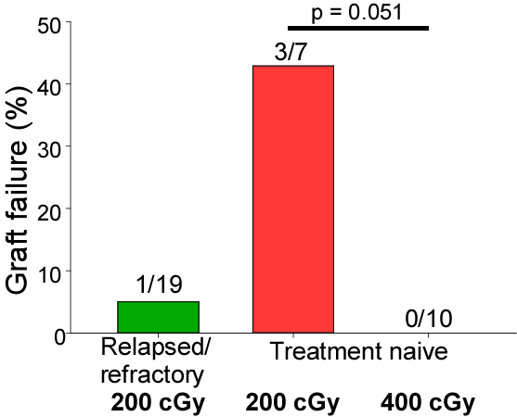
400 cGy TBI reduces graft failure in treatment naïve SAA
1/23
0/15

Slide 13
Robust Engraftment
CHIMERISM | Treatment-Naïve Patients 200 cGy | Treatment-Naïve Patients 400 cGy
100% Donor Day 60 Myeloid | 71% (n= 7) | 100% (n=13)
100% Donor Day 60 T cell | 57% (n= 7) | 100% (n=13)
100% Donor Day 360 Myeloid | 100% (n=4) | 100% (n=12)
100% Donor Day 360 T cell | 100% (n= 4) | 90% (n=12)
Notes:
Day 60 is most predictive
Show MOST recent!
Show endpoint!

Slide 14
Platform’s Overall Survival is Excellent 93% for all patients
OS
Relapsed/refractory 100%
Treatment-naïve 84%
Probability
Includes 2pts at 200 cGy
OS 100% at 400 cGy
0 20 40 60 80 100 120
MONTHS

Slide 15
Robust Follow up
 | Treatment- Naïve
Median follow up (months)* | 31.1
Off IST | 82%
*By reverse Kaplan Meier Method

Slide 16
Primary hypothesis and study design
Primary hypothesis: Optimizing the conditioning regimen for upfront bone marrow transplantation for adult patients with aplastic anemia will result in improved curative outcomes, regardless of age and donor availability
Study design Prospective, multicenter, phase II study in patients receiving transplant for severe aplastic anemia
Haploidentical (cohort 1, 30 patients)
Unrelated (cohort 2, 30 patients)

Slide 17
Study design: sample size justification
Primary objective: Estimate overall survival at one year post-HSCT in patients with SAA
Separate estimates in each cohort with the goal of achieving ≥75% 1-year survival
With 30 patients, if there is 1-year survival of 75%, we will be 95% confident that the 1-year survival exceeds ~60%. If it is 90%, we will be 95% confident that 1-year survival exceeds 79%.

Slide 18
Trial Design: Conditioning & GVHD Prophylaxis
BONE MARROW GRAFT: Target 4x10⁸ nucleated cells/ kg pt IBW
(minimum 2.5x10⁸)
400 cGy

Slide 19
Accrual
60 adult participants age 21 year and older
30 haplos, 30 URDs
Additional patients screened, consented, and registered in order to reach accrual goals
Accrual estimate: 3 years
Patients to be followed for 1 year post-HSCT

Slide 20
Feasibility & Logistics
Single center study (NCT02833805) accrued 22 children and adults over 3 years
Only haplos
Only relapsed or refractory
60 adults UN-treated with HAPLO or URD over 3 years is feasible
BMT CTN 1502 also accrued reasonably and that momentum should carry over
Also confidence with platform
Should not compete with any pediatric trials of similar populations

Slide 21
External Review & Online Feedback
Rated #1 of 3 by both external reviewers
Reviewed favorably online
SOSS Committee name | Concept # | Concept Short Title | Concept Descriptive Title | Total # of Votes | Mean | Median | Mode | Range
Non-Malignant Disorders | NMD 2 | Upfront Alternative Donor BMT for SAA | Hematopoietic reconstitution for adults with treatment-naïve SAA | 75 | 2.8 | 2 | 2 | 1-7

Slide 22
Thank you

Slide 23
External Review & Online Feedback
The proposals are all excellent.
cannot have too many network pilot studies. and need critical review of which are most feasible SAA project has most patients and should be top priority
#2: great need to find this answer
Upfront haplo HCT for SAA is a very promising approach
I am very glad to see the proposal of BMT in adults with SAA.
For the proposed SAA Trial, at time of protocol development, ensure that there are not funded studies competing for the same patient populations/eligibility (using MUD for #2; BMF for Treo study)
These single arm designs will be uninterpretable. The SSA one could be improved by targeting a very high OS at a minimum of 3 years.
Proposals #2 are highly relevant for the field.

Slide 24
External Review & Online Feedback
Reviewer 1: This seems the most feasible of the study proposals – a ‘single disease’ entity (I accept probably not, but it is at least phenotypically homogenous). HSCT with any donor is now relatively safe, compared with historic data, and long term immunosuppression may have significant morbidities. The study seems feasible in the nproposed timescale.
Reviewer 2: Upfront alternative donor BMT for SAA. Comments: clearly important issue in the field + could certainly change practise + requires CTN. Given that there is already a reasonable body of data suggesting the efficacy of alternative donor SCT with PTC, I would recommend the authors consider being bolder and performing a randomised study of IS vs alternate donor SCT (UD or haplo depending on donor availability) with PTC in adults under the age of perhaps 40 or 50 which is what the field really needs going forward.

Slide 25
Q&A Session

