Slide 1
SOSS Committee Optimal Donor and Graft Sources:
Haploidentical vs Unrelated Donor Transplantation with Post-transplant Cyclophosphamide (PTCy)
Karen Ballen, MD
University of Virginia

Slide 2
Conflict of Interest Disclosure
No Conflicts to Disclose

Slide 3
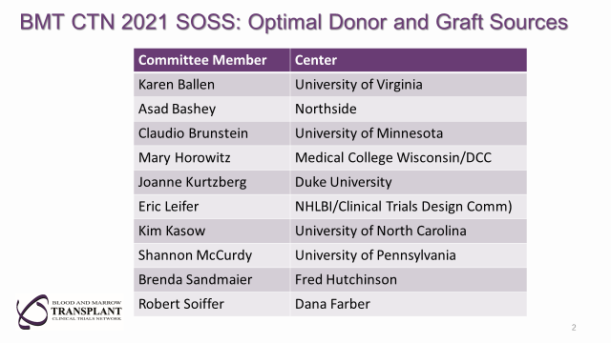
Committee Members

Slide 4
Proposed Study Concepts
Strategy 1: Haploidentical vs Unrelated Donor Transplantation with Post-transplant Cyclophosphamide (PTCy)
Strategy 2: GVHD Prophylaxis for Mismatched Unrelated Donor Transplantation.
Strategy 3. Reducing Toxicity of Umbilical Cord Blood Transplantation in Leukodystrophies

Slide 5
Haploidentical vs Unrelated Donor Transplantation with Post-transplant Cyclophosphamide
Hypothesis:
Unrelated Donors (UD, intervention) provide better two year overall survival than Haploidentical Donors (Haplo, control).
Importance to Field:
No Randomized Published Data to Date to Answer this Question
Crucial, Everyday Question for Many Transplant Centers
Use of mismatched unrelated donors (MMUD) opens eligibility to patients of diverse ethnic and racial backgrounds

Slide 6
Background & Significance
Control of alloreactivity by Post Transplant Cytoxan (PTCy) enabled safe use of Haplo donors
Retrospective comparisons show similar survival with haplo/PTCy and MUD with traditional calcineurin inhibitor based GVHD prophylaxis
PTCy may also improve outcomes following matched and mismatched UD transplants
Selection of MUD and MMUD may allow optimization of other donor characteristics, including donor age.

Slide 7
Trial Design
Phase III trial randomizes patients to best available UD (MUD or MMUD) vs best haplo PBSC graft as soon as it is known that an HLA-matched relative is not available – analysis by Intention to Treat
Myeloablative and reduced intensity strata
GVHD prophylaxis PTCy/mycophenolate mofetil/CNI (+others?)
Patients 18-75 with acute leukemia in CR1 or myelodysplasia with < 5% blasts
Primary endpoint: two-year survival
Secondary endpoints: time to transplant, TRM, relapse, QOL, CRS, cost
Sample size estimates assume 55% two-year survival with Haplo, based on CIBMTR data, and a two-sided 0.05 significance level
824 (1050) patients to detect absolute 10% improvement with 80% (90%) power

Slide 8
Feasibility & Logistics
CIBMTR data indicate >2000 patients eligible for this study are transplanted in the US annually
Anticipated accrual time is 2-3 years.
Post transplant maintenance would be permitted
Other details of supportive care, donor selection guidelines to be developed by protocol team

Slide 9
External Review
“No matter what the answer, it will help us in deciding which to do when there is a choice.” (Forman-2)
What happens to patients who do not have an available UD – physician choice but analyzed by ITT
Haploidentical donors easier to resource quickly – inherent part of the strategy to be tested; time to transplant will also be measured
Donor age may be different in the groups: inherent part of the strategy to be tested; donor age will be captured
Are there data to support the 2-year 55% survival rate? 55% survival rate determined from CIBMTR data on potentially eligible patients receiving haplo
What is the current 2-year survival of UD with PTCy? Two-year survival is 65% for patients transplanted in 2015-2020, according to CIBMTR data

Slide 10
Online Feedback-Median Score of 2
How does this trial differ/add to ongoing trials in Europe?
NCT04067180 – Haplo vs matched unrelated for AML-prefer BM but accept PBSC
BM preferred over PBSC
MUD GVHD prophylaxis: Center discretion
Need to identify matched unrelated donors - would limit racial/ethnic diversity, exclude high risk patients, many diverse patients and early relapsers
200 patients - too small for definitive results
NCT03655145 – Haplo vs MUD using MAC only
MUD PBSC / Haplo BM
Need to identify matched unrelated donors - would exclude many diverse patients and early relapsers
334 patients - too small for definitive answer
NCT03275636 – Haplo vs MMUD (HAMLET)
Different question
266 patients

Slide 11
Issues Raised That Would Need to be Clarified by the Protocol Team at Time of Protocol Development
Use of Bone Marrow in addition to PBSC
Degree of mismatch allowed for UD
Conditioning regimens to be allowed
Inclusion of drugs beside MMF/CNI with PTCy
Other Secondary Objectives: impact of molecular/cytogenetic risk factors, KIR, specific mismatches and cryopreservation
Inclusion of pediatric patients if COG study not moving forward
Inclusion of CR 2 patients

Slide 12
Q&A Session

