Slide 1
Pediatric Malignant Diseases Committee: The CAR-CURE Trial
Leslie S. Kean, MD, PhD

Slide 2
Conflict of Interest Disclosure
Leslie Kean: Novartis: SAB, BMS: research funding, Gilead: Research funding and SAB, BEAM: research funding

Slide 3
Committee Members
Chair:
Leslie S Kean MD/PhD, Dana-Farber Cancer Institute and Boston Children’s Hospital
Members:
Alice Bertaina, MD/PhD, Stanford Lucille Packard Children’s Hospital
Marie Bleakley MD/PhD, Fred Hutchinson Cancer Research Center
Joseph Chewning MD, University of Alabama
Stella Davies MD/PhD, Cincinnati Children’s Hospital
Dean Lee MD/PhD, The Ohio State University, Nationwide Children’s Hospital
Rachel Phelan MD, Medical College of Wisconsin
Michael Pulsipher MD, Children’s Hospital of Los Angeles
Muna Qayed MD, Children’s Healthcare of Atlanta, Emory University
Nirali N. Shah MD, National Cancer Institute, NIH
Vicky Wu PhD: Fred Hutchinson Cancer Research Center
Ad Hoc Members for the CATCH Trial:
Susanne Baumeister MD, Dana-Farber Cancer Institute and Boston Children’s Hospital
Rizwan Romee MD, Dana-Farber Cancer Institute
Roman Shapiro MD, Dana-Farber Cancer Institute
Ad Hoc Members for the KARMA Trial:
Terri Guinipero MD, Nationwide Children’s Hospital
Maggie Lamb MD, Nationwide Children’s Hospital

Slide 4
Committee Scope
Pediatric Malignant Disease: How do we address the most important questions facing patients with malignant disease who are undergoing hematopoietic stem cell transplantation and cellular therapies?
→ALL:
Can CAR-T cells be used as a stand-alone therapy for high risk/relapsed patients, or should CAR-Ts be used to induce a deep remission prior to transplant?
→ AML:
Can we prevent and/or treat relapse in patients with high-risk (incl. MRD+) AML by incorporating cellular therapies?

Slide 5
Proposed Study Concepts
The CAR-CURE Trial:
  A Risk-Based Approach to Optimize Remission Duration Following CD19-CAR-Ts
  CAR T-cells for Long-Term Cure: A Randomized Risk-Based Approach to Post-CAR T-cell Consolidation with HCT
The CATCH Trial:
  Phase 1/1b Pediatric CIML NK trial to treat relapsed AML/MDS/JMML post Haploidentical and Matched-Sibling Donor HCT
  CIML-NK Cells To Treat Post-HCT Myeloid Relapse
The KARMA Trial:
  Killer cells Against Relapsed Myeloid Acute leukemias
  Phase I/II Clinical Trial Evaluating the Safety and Efficacy of IL-21-Expanded Universal Donor Natural Killer Cells for Relapsed/Refractory Acute Myeloid Leukemia

Slide 6
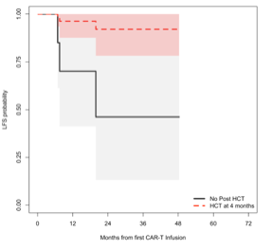
Optimizing the curative potential of CAR T-cell therapy will improve leukemia free survival
CD19 CAR T-cells are highly effective in children and young adults with relapsed/refractory (r/r) B-ALL with potential for long-term cure
Substantial fraction of patients will relapse by 1year post-CAR
Post-CAR HCT associated with improved LFS in children and young adults following CD19 CAR T-cells (Summers et al, Shah et al)
Maude et al.
NEJM 2018
HCT at
4 months
No HCT
Summers et al.
in review

Slide 7
Optimizing the curative potential of CAR T-cell therapy will improve leukemia free survival
CD19 CAR T-cells are highly effective in children and young adults with relapsed/refractory (r/r) B-ALL with potential for long-term cure
Substantial fraction of patients will relapse by 1year post-CAR
Post-CAR HCT associated with improved LFS in children and young adults following CD19 CAR T-cells (Summers et al, Shah et al)
Maude et al.
NEJM 2018
HCT at
4 months
No HCT
Summers et al.
in review

Slide 8
Can we use new technology to optimize outcomes?
Can we avoid transplant in
some of these patients?
Can we improve outcomes
compared to historical rates?

Slide 9
The CAR-CURE Trial: Overview
A standardized approach incorporating serial monitoring of biologic factors to risk-stratify those at high risk of post-CAR relapse will be able to:
  Direct high-risk patents to HCT and improve their leukemia free survival (LFS)
  Avoid HCT in those who will achieve long-term cure with CAR T-cells alone
Risk-based HCT would ideally lead to avoidance of HCT in 50% patients while directing those highly likely to relapse to HCT

Slide 10
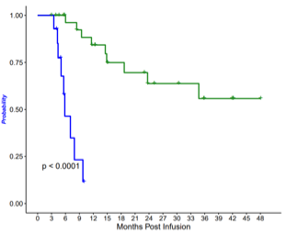

Undetectable NGS (marrow) on day 28 and at 3 months was associated with improved EFS and OS
EFS in CR/Cri patients by month 3 NGS MRD status
(n=46)
NGS = 0
NGS > 0
Confidential: Embargoed data currently under consideration by journal

Slide 11
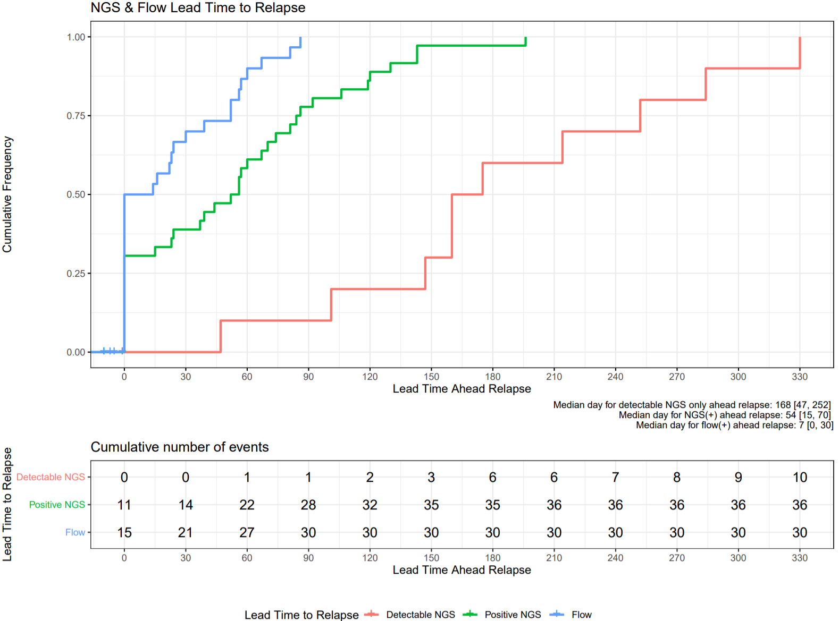
NGS MRD assessments facilitated earlier detection of impending relapse
NGS and Flow Lead Time to Relapse (n=47)
Marrow disease assessment | Median day prior to relapse | Range (days)
Flow | 7 | 0-30
NGS (+) | 54 | 15-70
NGS (detectable) | 168 | 47-252
Relapse: n=47; flow: 594 samples; NGS: 218 samples
Flow > 0.01% of MNC
Positive NGS (>10⁻⁶)
Detectable NGS > 0
Cumulative Frequency
Lead time ahead of relapse (months)
Relapse: > 1% PB blasts or > 5% in BM
(*CR/Cri)
Confidential: Embargoed data currently under consideration by journal
Notes:
Clinical relapse population with NGS/flow data available (n=47): 594 samples had flow results, and 218 samples had NGS results
Clinical relapse: >1% blast in blood or >5% in BM or extramedullary disease in CR/CRi patients
Flow MRD(+): >=0.01% malignant cells out of total viable WBCs
Positive NGS MRD: MRD(+) at detection level of 10⁻⁶
Detectable NGS MRD: MRD >0 & MRD(-)

Slide 12
NGS MRD assessments facilitated earlier detection of impending relapse
NGS and Flow Lead Time to Relapse (n=47)
Marrow disease assessment | Median day prior to relapse | Range (days)
Flow | 7 | 0-30
NGS (+) | 54 | 15-70
NGS (detectable) | 168 | 47-252
Relapse: n=47; flow: 594 samples; NGS: 218 samples
Flow > 0.01% of MNC
Positive NGS (>10⁻⁶)
Detectable NGS > 0
Cumulative Frequency
Lead time ahead of relapse (months)
Relapse: > 1% PB blasts or > 5% in BM
(*CR/Cri)
Confidential: Embargoed data currently under consideration by journal
Notes:
Clinical relapse population with NGS/flow data available (n=47): 594 samples had flow results, and 218 samples had NGS results
Clinical relapse: >1% blast in blood or >5% in BM or extramedullary disease in CR/CRi patients
Flow MRD(+): >=0.01% malignant cells out of total viable WBCs
Positive NGS MRD: MRD(+) at detection level of 10⁻⁶
Detectable NGS MRD: MRD >0 & MRD(-)

Slide 13
Hypothesis: A risk-based approach incorporating serial marrow/PB NGS will direct patients towards proceeding to or avoiding HCT, leading to
• 1-year LFS of ≥ 70% that is not inferior to proceeding directly to HCT • 1-year LFS higher than LFS with CAR T-call alone

Slide 14
Hypothesis: A risk-based approach incorporating serial marrow/PB NGS will direct patients towards proceeding to or avoiding HCT, leading to
• 1-year LFS of ≥ 70% that is not inferior to proceeding directly to HCT • 1-year LFS higher than LFS with CAR T-call alone

Slide 15
Trial Design: Risk-Based Intervention Following Randomization
Day 42: MRD neg remission post CAR (by FC)
NGS MRD positive
MA TBI HCT
Proceed to HCT within 4 weeks of NGS+ results
(interval therapy allowed)
Marrow MRD
(NGS and Flow)
  Months post-CAR:
  1, 2, 3, 6, 9, 12
Peripheral blood MRD:
  Q2 weeks centralized NGS
NGS MRD negative
Continue to monitor
Loss of B-cell aplasia (≤ 6 months of CAR T cells) or
NGS MRD positive

Slide 16
Primary Outcome: To determine if the use of a risk-based approach will have a similar LFS as the HCT arm
Leukemia free-survival (LFS) at 1-year post CAR
HCT arm vs the risk-based HCT Arm
  Intent to treat
  Non-inferiority: risk-based HCT arm
Events:
  Death
  Relapse
    Pre-HCT (defined by FC+ recurrence)
    Post-HCT (defined by FC+ leukemia after HCT)
Notes:
A randomized study usually has a standard arm and an experimental arm
And usually the hypothesis is that the experimental arm is better than the standard arm, or if it is a de-escalation of therapy, then the experimental arm is the same as the standard arm while reducing toxicity
This one is challenging, since we don’t have an acceptable standard – if we argue that the HCT arm is standard
Then we hypothesize that the risk adaptive approach will maintain EFS while decreasing overall toxicities by reducing HCT (since EFS is outcome, a slight increase in relapse would possibly be offset by avoiding more TRM?)

Slide 17
Secondary and Exploratory Outcomes
Secondary
LFS at 1 and 2-years post CAR comparing HCT arm vs risk-based HCT Arm
  Intent to treat, and
  Actual intervention (e.g., if HCT arm refuses HCT)
Exploratory
Describe the role of PB NGS monitoring
Identify factors associated with risk of relapse following CD19 CAR T-cells (e.g., pre-CAR disease burden)
PROs and late effects post CAR and HSCT
Cost-analysis

Slide 18
Statistical Analysis
1A: Planned HCT post-CAR-T Arm
  Will include patients who are both NGS+ (FC-) and NGS neg
  Expect a 1-year LFS of ≥70%
1B: Risk-based HCT arm
  Anticipate that at least 50% of patients will not receive HCT
  Patients go to HCT because they are NGS+ or they lose B-cell aplasia within 6m.
  This will improve outcomes from the 40-50% EFS expected with CAR-T alone.
  Expect a 1-year LFS of 68% in the risk-based arm
If outcomes are similar, the risk-based HCT arm would be preferred as it decreases exposure to HCT risks.

Slide 19

Feasibility, Sample Size, Logistics
With 60 patients per each randomized arm,
  Significance level of 0.1 and noninferiority margin of 0.2
  LFS of HCT arm: 70% and risk-based arm: 68%
Annually, approximately 80-100 children infused with CD19 CAR T-cell
Enrollment:
  Patients would be enrolled (ideally) prior to first disease assessment but ≤ day 42 post-CAR
  All patients (including those who decline randomization) would have serial assessment of NGS (peripheral blood NGS every 2 weeks and bone marrow NGS month 1,2,3,6,9,12 )
HCT Planning:
  First HCT only
  TBI-based conditioning

Slide 20
External Review & Online Feedback:
Average Score: 2.35
Summary/clarification of main discussion points:
  NGS MRD testing will be centralized by Adaptive
    Will account for both CD19+ and CD19-neg relapses
  B-cell aplasia will be monitored throughout the study, probably centralized
  All patients must have a HCT donor identified
    There will be variability in HCT approaches (e.g., donor) but consistently TBI based
  CAR T-cell product:
    Kymriah or a similarly persistent 4-1BB based CD19 CAR

Slide 21
Conclusion
CAR T-cells are highly effective in children and young adults with relapsed refractory ALL, however some patients will not achieve long-term cure without consolidative HCT.
With the dual goals of improving overall LFS and reducing late-effects, we propose that a standardized risk-based approach utilizing state-of-the-art methods for disease detection and evaluation of functional CAR T-cell persistence will direct high-risk patients to HCT and spare low-risk patients from HCT toxicities.
Role of PB and BM NGS testing will also be closely evaluated and may change the paradigm for post-CAR/HCT relapse monitoring.
Notes:
MQ : Omit this slide?

Slide 22
Q&A Session

