Slide 1
Plasma Cell Disorders Committee :
Incorporating BCMA CAR-T in High Risk Multiple Myeloma (HRMM)
Parameswaran Hari

Slide 2
Conflict of Interest Disclosure
Consulting Honoraria from:
BMS / Celgene; Janssen; Takeda; Amgen; Karyopharm; GSK

Slide 3
Committee Members
Committee Member | Center
Amrita Krishnan | COH
Damien Green | FHCRC
Ed Stadtmauer | U Penn (CTN SC)
Krina Patel | MDACC
Luciano Costa | UAB
Madhav Dhodapkar | Emory
Marcelo Pasquini | DCC Liaison
Noopur Raje | DFCI
Parameswaran Hari | MCW (Chair)
Phil McCarthy | Roswell Park
Saad Usmani | Levine Cancer Institute
Sergio Giralt | MSKCC
Shaji Kumar | Mayo
External Reviewers | Center
Xavier Leleu | France
Maria Victoria Mateos | Spain

Slide 4
State of the Clinical Science in MM in 2021
Minimal Residual Disease and its correlation with temporal outcomes
FDA narrowly defines what can and cannot be used for stratification decisions in trials
Progress in :
Induction – mAb containing quadruplets induce deeper MRD
CAR-T – in RRMM
T cell – MM cell bi specific engagers
Lack of Progress:
High Risk MM
Relapse still an issue – in SR MM / in RR MM despite new agents
Limiting time on treatment (de escalation of maintenance)

Slide 5
Proposed Study Concepts
Strategy 1: Incorporating BCMA CAR-T in High Risk Multiple Myeloma (HRMM)
Top ranked concept by reviewers and top voted
Strategy 2: Concentrated Upfront Therapy to Eliminate MM (CURxE-MM)
SR MM pts MRD neg after induction → randomize to either ASCT + Dara/Len maintenance vs. T cell engager bispecific Ab. Stop all intervention at 1 yr if sustained MRD neg.
Strategy 3: Post CAR-T maintenance to prevent relapse (RRMM)
Multiple parallel strategies of planned post CAR T maintenance for commercial BCMA CART recipients (RRMM) – e.g. BCMA directed T cell engager or IMID maintenance

Slide 6
Hypothesis
High Risk MM patients have not benefited significantly from recent improvements in therapy
Sustained MRD negativity can be induced by quadruplet induction/ASCT → followed by CAR-T and maintenance
Sustained MRD Neg is the means to overcoming high risk at baseline
Baseline risk did not matter if MRD neg
S1211 Trial
Usmani et al. The Lancet Haematology, 2021 ISSN: 2352-3026, Vol: 8, Issue: 1, Page: e45-e54
Paiva B et al. Journal of Clinical Oncology 2020 38:8, 784-792

Slide 7
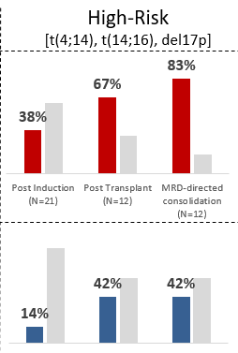
Background & Significance
Munshi N et al. N Engl J Med 2021;384:705
Kaufman J et al. ASH 2020 Abstract 549
Costa LJ et al. ASH 2019 Abstract 860
Strategies associated with high MRD negativity rates:
Quadruplet Induction: Dara-RVD > RVD; Dara-KRD
BCMA CAR-T – Majority in CR after CAR-T are MRD neg
26/33 in CR
GRIFFIN TRIAL | D-RVd | RVd
MRD negative regardless of response | 46/104 (44.2) | 15/103 (14.6)
In patients who received ASCT | 45/94 (47.9) | 14/78 (17.9)
10⁻⁵
10⁻⁶
Dara KRD – MASTER trial

Slide 8
Trial Design
Revised ISS-3
Revised ISS-2 with:
FISH for t(4;14), t(14;16), t(14;20), Del17p, > 3 copies of chromosome 1q21
Genomic: GEP70^{hi}, SKY92^{hi}, bialleleic TP53 deletion, c-Myc rearranged / mut
Imaging: >3 FDG avid bone lesions on PET-CT
Extra-medullary disease at diagnosis
Circulating plasma cells >5% at diagnosis
MRD Testing
MRD Testing
MRD Testing
MRD Testing
If sustained MRD-ve at 1 year, stop.
If MRD+ve, continue RV-Dara to progression
RV-Dara
X 1 year
Up to prior 2 cycles enroll
Minimum
RVd-dara
X 4 cycles
HDM/
ASCT
BCMA CART
R
TCE
X 1 year
If sustained MRD-ve at 1 year, stop.
If MRD+ve, continue BCMA BsAb to progression
MRD Testing
Enroll
Post ASCT
Assumptions:
S1211 – no identified regimen better than RVD
MRD negativity (10⁻⁶) is an important goal in HR-MM

Slide 9
Trial Design
INDUCTION:
- Mandated 4 cycles of Anti CD38 mAb + RVD
Auto Transplant – SOC
- T cell apheresis pre-ASCT
BCMA CAR-T 90-120 d p ASCT
Randomized Maintenance
RV-Dara x 1 yr vs. T Cell Engager x 1 yr
Discontinue all therapy is sus MRD neg
Treatment Goals
Achieving sustained MRD negativity
Threshold:10⁻⁶/ by NGS
Sustained: 1 year apart
Primary Endpoint
Co-Primary:
PFS @ 3 years
MRD Status @ 1 year post-CART
CONTROL POPULATION:
Concurrent similar HR MM from select CIBMTR centers (not participating in study)
Meet criteria and receive ASCT as SOC
Targeting a 15% improvement in 3 yr PFS
Median PFS in controls of 34 mo
Delta median PFS of 18 mo
174 pts to be enrolled over 3 years
Caveat: No final protocol at this stage

Slide 10
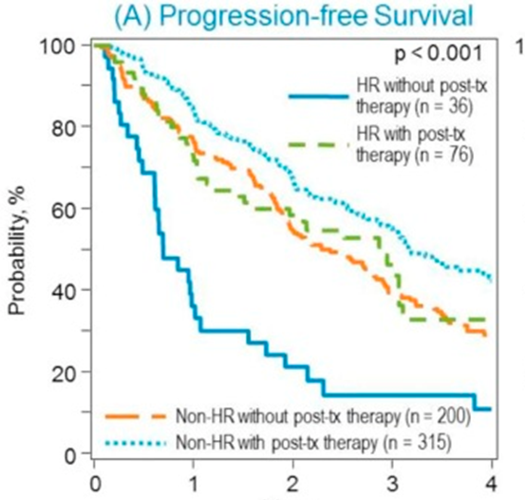
Feasibility & Logistics
Available patients:
~17.5% of all SCT pts in MM (CIBMTR)
Approx. 1000 pts per year in the US
Vast majority in CTN centers
3 yr PFS (current) – 37%
CONTROL GROUP: contemporary non-randomized prospective cohort of patients meeting same eligibility criteria, but who are treated with ASCT at centers not participating in the trial
Has been performed successful in CTN 1203
Scott E et al Biol. Blood Marrow Transplant 2016 Oct;22(10):1893
Bolanos Meade et al. Lancet Haem.2019 Mar;6(3):e132

Slide 11
External Review & Online Feedback
SOC tandem ASCT based on EMN and Stamina trials?
Why not to go directly to CAR-T without ASCT?
The sensitivity level for MRD might be, if possible 10-6, to ensure the discontinuation of therapy and combined with imaging.
The proposal is a bit conservative in terms of improvement with respect to the control
The definition of HRMM need to be strict. e.g R-ISS 2 with high risk CG?
The impact of ASCT consolidation vs. CART might be difficult to determine
Primary end point – should it be MRD Neg status?
Are we ready to stop therapy if MRD Neg? Should they need continued maintenance?
What if pt reaches MRD Neg – pre CART or pre maintenance etc?
Why not do a diff design: Randomize to ASCT + triplet maintenance vs. ASCT + T cell engager vs. ASCT + CART + maintenance?
Other online voting:
High-risk concept is simple, feasible, and addresses an important question for a subset of myeloma patients where significant progress is needed.
Quite ambitious
N | Mean | Medn | Mode | Range
52 | 2.6 | 2 | 2 | 1-5
52 | 3.4 | 3 | 3 | 1-9
52 | 3.4 | 3 | 3 | 1-8

Slide 12
Q&A Session

