Slide 1


A Prospective Observational Study of the Immunogenicity of SARS-CoV-2 Vaccines for Patients Receiving autoHCT, alloHCT, and CAR-T
A CIBMTR and BMT CTN Study
Study Chairs: Joshua Hill, Miguel Perales, Marcie Riches
Protocol Officer: Mary Horowitz
Funding: National Marrow Donor Program/Be the Match, Leukemia and Lymphoma Society,
Multiple Myeloma Research Foundation, LabCorp, American Society of Transplant and Cellular Therapy, Fred Hutchinson Cancer Research Center Philanthropy

Slide 2
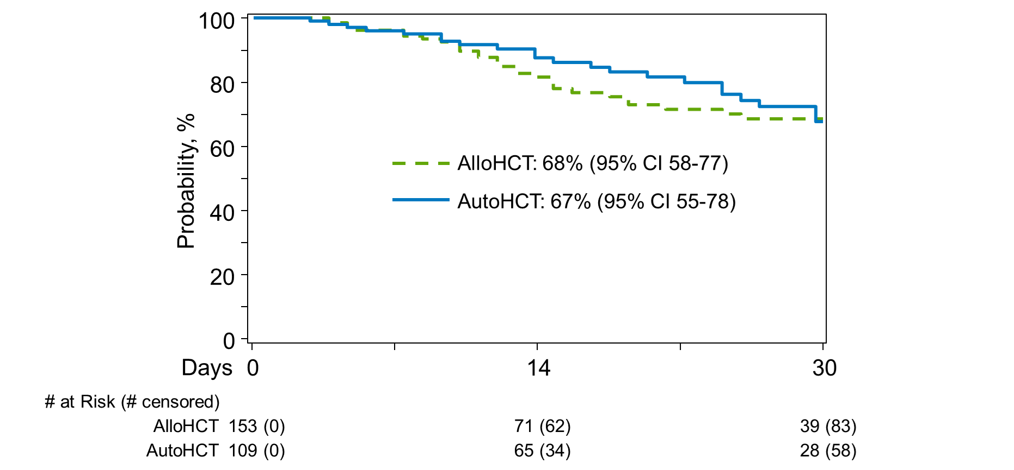
Background
Developed from the BMT CTN State of the Science Infection & Immune Reconstitution Committee
Lack of immunogenicity data for any of the available vaccines in HCT/CAR-T patients
HCT/CAR-T patients at particular risk for severe/fatal complications from COVID-19 infection¹
Vaccine responses in solid organ transplant recipients appear decreased²
OS at 30 days post COVID Diagnosis

Slide 3
Hypotheses
SARS-CoV-2 vaccines will be safe and immunogenic in 40 – 60% of patients vaccinated in the 1st year post HCT/CAR-T infusion
Immunogenicity will be higher in patients receiving vaccination between 6 and 12 months after HCT/CAR-T compared to <6 months after HCT/CAR-T

Slide 4
Study Overview
Observational Study of HCT/CAR-T recipients receiving a COVID vaccine as part of SOC
Inclusion Criteria
≤ 12 months from allo/auto/CAR-T at time of baseline sample
Any age
Consented to provide CIBMTR data with a valid CRID
OK if prior COVID-19 infection if at least 3 months prior
OK if previously received a COVID-19 vaccine prior to HCT/CAR-T
Exclusion Criteria
No consent for the CIBMTR Database Protocol

Slide 5
Primary Objective
Compare immunogenicity of SARS-CoV-2 vaccines in patients vaccinated <6 months and 6 – 12 months within each strata
  Immunogenicity measured at 14 – 35 days after a single-dose vaccine or 7 – 35 days after 2nd vaccine dose for a two-dose vaccine
  Immunogenicity: ≥ 4-fold increase in SARS-CoV-2 binding antibodies to the spike protein receptor-binding domain (RBD) from pre-vaccine level
  Total antibody against the receptor-binding domain (RBD) of the Spike protein of SARS-CoV-2 assessed using a semi-quantitative Electrochemiluminescence Immunoassay (ECLIA).

Slide 6
Secondary Objectives
Assess durability of the vaccine response at 6 months post 2nd dose of vaccine based upon RBD Ab titer (7 months from initial/single vaccine)
Determine max RBD Ab titer and compare to the general population clinical trial participants
Describe patient reported Grade 3-4 vaccine-related adverse reactions
Determine incidence and severity of COVID-19 infections by 6 months post 2nd dose of vaccine (7 months from initial/single vaccine)
Estimate incidence of new/worsened GVHD following immunization (Allo patients)

Slide 7
Exploratory Objectives
Assess the immunogenicity of each vaccine separately
Assess immunogenicity in patients with and without prior COVID-19 infection/vaccination
Assess immunogenicity in alloHCT recipients with and without GVHD
Assess immunogenicity in alloHCT recipients according to GVHD prophylaxis
Assess immunogenicity in autoHCT recipients according to underlying disease and post-HCT maintenance therapy
Assess immunogenicity in CAR-T cell recipients according to history and treatment of cytokine release syndrome
Identify patient characteristics associated with immunogenicity, including age, sex, race and ethnicity, performance score

Slide 8
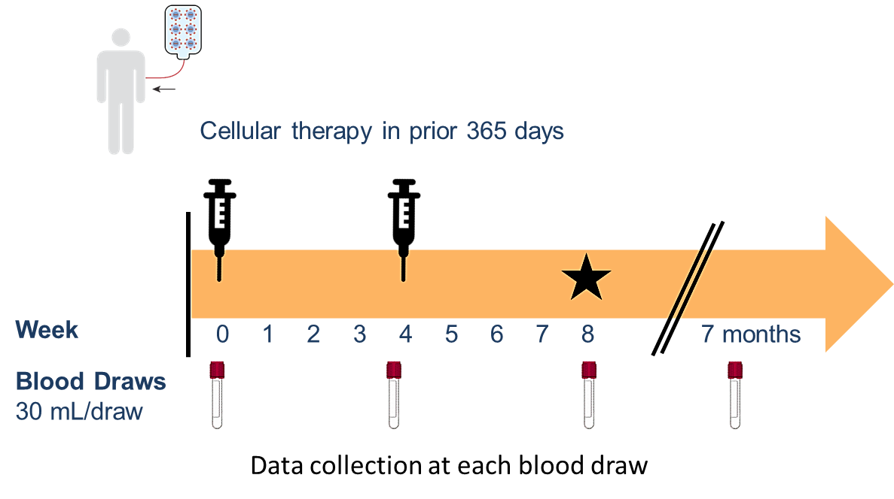
Study Schema
Time post HCT/CAR-T | AutoHCT | AlloHCT | CAR-T
<6 months | 108 | 150 | 108
6 – 12 months | 108 | 150 | 108
*
*Note: if single dose vaccine, will still collect the sample at ~4 weeks and ~8 weeks post vaccine

Slide 9
Sample collections
Sample | Window
Sample 1: Baseline (Pre-vaccination) | Up to 14 days prior to vaccine administration
Sample 2: Post Vaccine #1 | Single dose vaccine: 14 – 35 days after vaccine; Two dose vaccine: no sooner than 7 days prior to 2nd dose
Sample 3: Post Vaccine #2 (2nd assessment for single vaccine) | Single dose vaccine: earliest clinical visit b/w 4 – 8 weeks after sample 2 Two dose vaccine: between 7 – 35 days after vaccine
Sample 4: 7 months from initial vaccine | Closest routine clinical visit, ideally ± 28 days
* Standard of Care CBC with differential required at each time point

Slide 10
Sample Acquisition and Disposition
30 mL blood for serum and PBMCs sent to CIBMTR Research Repository
  4.5 mL in SST Clot tube
  8.5 mL each in three 10 mL sodium heparin tubes
CIBMTR Repository will batch ship 1 mL aliquots to LabCorp for the SARS-CoV-2 Semi-Quantitative Total Ab, Spike Test
  After all 4 samples for a patient are completed, results will be provided back to the center for discussion with the patient
Remaining samples stored for future studies including
  Neutralizing Ab assays
  T-cell function studies

Slide 11
Data
Clinical and demographic data from data routinely submitted to CIBMTR
Supplemental data:
  Vaccine manufacturer and date of administration
  History of prior COVID-19 infection with date
    Center should ensure completion of CIBMTR form 2149
  Selected medications from drop down list
  GVHD assessment (Allos)
  Other post-therapy vaccinations with dates
  Karnofsky Performance Score
  CBC results
  Grade 3-4 patient reported vaccine-related toxicities [post-vaccine time points]

Slide 12
Logistics
Study conducted under the CIBMTR Data and Repository Consents
  Patients must have signed the CIBMTR Data Consent
A separate consent for the specimen collection is required
  Consent already approved by the NMDP IRB
  Consent is a new (and separate) ICF for the CIBMTR repository
Data submission
  Via FormsNet (CIBMTR standard data reporting) & eClinical (BMT CTN platform)
  If COVID-19 infection occurs, CIBMTR form 2149 should be completed in FormsNet

Slide 13
Logistics
Accrual anticipated to be < 9 months from study initiation
Goal: first patient in by end of April
Reimbursement
  Study data form: $100/time point
    If CIBMTR 2149 required, standard CIBMTR reimbursement additionally provided
  Samples: $100/sample received
  Centers receive all reimbursement through the same mechanism as standard CIBMTR reporting
Centers receive BMT CTN Accrual Credit

Slide 14

Data Considerations
The Segment A Enrollment form in eClinical is expected to be completed on the day of the first specimen draw for the study.
  If consent is obtained prior to scheduling the vaccine, enrollment in eClinical is not to be completed until the day of the first specimen blood draw (up to 14 days prior to the scheduled vaccination).
The Site Guide provides an overview of each form for the study as well as specific fields on each form that may require clarification.
The Site Guide, Advantage eClinical User’s Guide, and GlobalTrace Guide can be found in the Study Materials Tab in eClinical. Additionally, the Site Guide will be posted to the CIBMTR SC21-07/BMT CTN 2101 subweb in the BMT CTN SharePoint
For assistance with Advantage eClinical or GlobalTrace contact bmtctn2101dm@emmes.com

Slide 15

Research Sample collections
GlobalTrace (GT) Visit | Time Point | Two dose vaccine administration | Single dose vaccine administration
V1 | Baseline: Pre-Vaccine #1 | Up to 14 days prior to vaccine administration | Up to 14 days prior to vaccine administration
V2 | Post Vaccine #1 | within 7 days prior to administration of the 2nd dose | 14 – 35 days after vaccination
V3 | Early Post Vaccine #2 or similar time frame after a single dose vaccine | Between 7 and 35 days post-vaccine dose #2 | Earliest clinical visit between 4 and 8 weeks after specimen obtained for time point 2 (V2).
V4 | 6-7 Months Post-Vaccination | Closest routine clinical visit to 6 months post-vaccination, ideally ± 28 days | Closest routine clinical visit to 7 months post-vaccination, ideally ± 28 days
A Standard of care CBC with differential needs to be done at the same time the research samples are collected and some results reported in the supplemental CRF.

Slide 16
Blood Collection Tubes
Site will need to provide the following blood collection tubes:
  10 mL fill green top plastic Vacutainer® tubes containing Sodium-Heparin anticoagulant (Fisher Scientific cat. No.: 02-689-6, BD Vacutainer® cat no.:367874)
  5 mL fill gold top plastic BD SST™ Vacutainer® tubes containing Silica Clot Activator, Polymer Gel, Silicone-Coated Interior (Fisher Scientific cat. no.:02-683-97, BD Vacutainer® cat no.:367986)
    OR
  7.5 mL fill red/gray top plastic BD SST™ Vacutainer® tubes containing Silica Clot Activator, Polymer Gel, Silicone-Coated Interior (Fisher Scientific cat. no.:02-683-95, BD Vacutainer® cat no.:367987)
Comparable smaller fill volume tubes may be used as long as the requested amount of blood sample is submitted to the BMT CTN Repository.

Slide 17
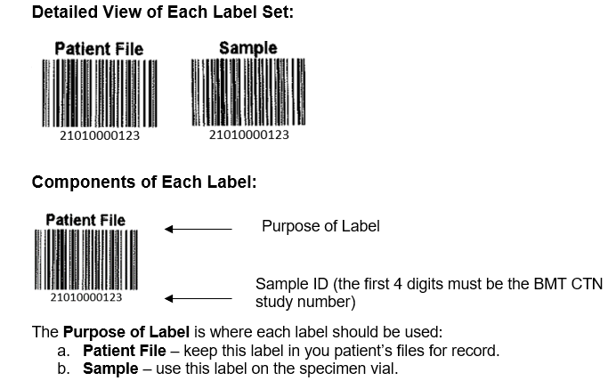
Labels
Labels will be provided for this study. Upon activation Emmes will send an initial supply to your site.
  When more labels are needed contact bmtctnac@emmes.com
Each blood tube needs to have a unique label applied

Slide 18
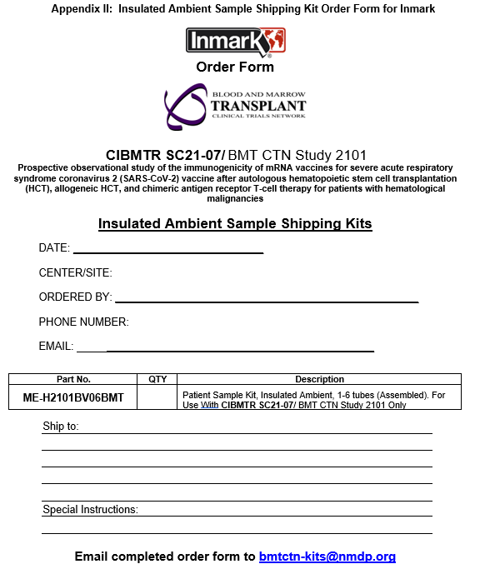
Shipping kits
Insulated ambient shipping kits are provided
  Sites must place an order for these using Appendix II of the Research Sample Information Guide
Kits should be ordered with at least a one-week lead time

Slide 19
Blood sample collection
At each of the four time points,
  Collect 5 mL blood in SST tube
  Collect 25 mL blood in NaHep tubes
The SST tube will need to clot for an hour and then be centrifuged prior to shipment.
  Do not centrifuge the NaHep tubes

Slide 20
Shipment
Samples can be shipped Monday – Friday to the BMT CTN Repository
  Instructions for creating a FedEx air bill are in the Research Sample Information Guide
    When sending on Fridays, you MUST select the “Saturday Delivery” option on the air bill
Enter the sample information into GlobalTrace
  Place samples into a shipment manifest
  Select BMTLB as the destination
  Add the FedEx tracking information to the shipment
  Final step = press SEND SHIPMENT to alert the repository to the samples being sent

Slide 21
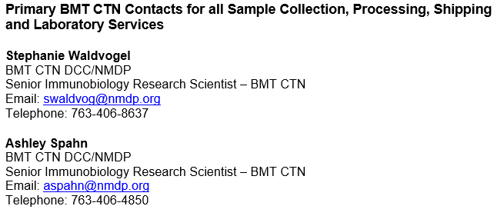
Sample Questions

Slide 22
Process for Opening Sites to Enrollment
Submit all required regulatory documents
  Information provided on Welcome Memo
Complete eClinical training
Request access to eClinical and Sharepoint if needed
Materials are posted on the public website under ‘Protocols’ and ‘2101’: https://web.emmes.com/study/bmt2/

Slide 23
CIBMTR Data Reporting 1
Consented to CIBMTR Research Database Protocol & have a valid CRID
This CRID must be entered on to the e-clinical Study Enrollment Form
CIBMTR randomization will assign TED/CRF/CTED track forms
CIBMTR Forms should be completed as they come due + F2149 (Covid-19 Infection Form)

Slide 24
CIBMTR Data Reporting 2
Pre-TED F2400 will not capture this study enrollment unlike all other BMT CTN studies
Study Plan – Appendix D is with key data field list
CIBMTR standard data reporting should be followed via FN3
Questions can be sent to kbhavsar@mcw.edu or
via CIBMTR Center Support in Service Now application. Please include study ID# SC 21-07/BMT CTN 2101.
https://nmdp.service-now.com/csm

Slide 25
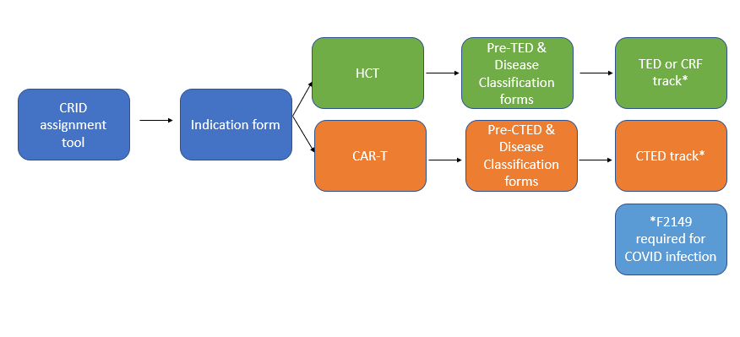
CIBMTR Data Reporting 3

Slide 26
Contact
Task | Contact Information
Protocol Coordination | Dinma Ahaiwe (bmtctn2101@emmes.com)
Advantage eClinical and GlobalTrace | Brittainy North (bmtctn2101@emmes.com)
Informed Consent | Ashley Spahn (RepositoryIRB@NMDP.org)
Specimen Submission | Stephanie Waldvogel (swaldvog@nmdp.org)
CIBMTR Data Reporting | Kavita Bhavsar (kbhavsar@mcw.edu)

